Slide 1

s
PareHub
Quality Parts, Seamless Service
Direct. Authentic. Reliable.

Slide 2

Project Title :
Spare Hub
Project Members:
Meet Parmar
Harsh Vaghela
Guide: Prof. Rachana Chaudhari
Farman Sunasara
Krish Kankuwala

Slide 3
Role of team members

Slide 4
Role of team members
Meet
Harsh
Creator
Helper
Farman
Krish
Research
Helper

Slide 5
definition
This project is a B2B platform that connects all type’s of vehicle parts manufacturers with shops, enabling shops to order parts directly from manufacturers while streamlining the ordering and inventory management process.
revolutionize the vehicle parts supply chain by creating a seamless connection between manufacturers of all types of vehicle parts and automotive repair shops, dealerships, and other related businesses

Slide 6
Problems solved by our idea
Availability of Genuine Parts
Time Savings
Centralized Communication
Cost & effort Savings
Quality Assurance
Transparency in Pricing

Slide 7
Future directions
Electric Vehicle (EV) Parts
OEM (original equipment manufacturer) Partnerships
Augmented Reality (AR)
24/7 Support
Recycling Programs

Slide 8
Study of similar ideas in the market
Application
Website
NAPA AUTO PARTS
advanceautoparts.com
EBAY MOTORS
carparts.com
AutoZone
rockauto.com
Parts Geek

Slide 9



Market research
Feature/Aspect | Spare Hub | Autodoc | PartsTech | AutoZonePro | NapaProLin
Intarface (easy to understand) | ✔ | ✖ | ✔ | ✖ | ✖
Focus on B2B (primary) | ✔ | ✖ | ✖ | ✖ | ✖
Wide Range of Suppliers | ✖ | ✔ | ✔ | ✖ | ✖
Pricing Transparency (Direct comparison) | ✔ | ✖ | ✖ | ✖ | ✔
Wide Range of Spare (Type’s of parts) | ✔ | ✖ | ✔ | ✔ | ✔

Slide 10
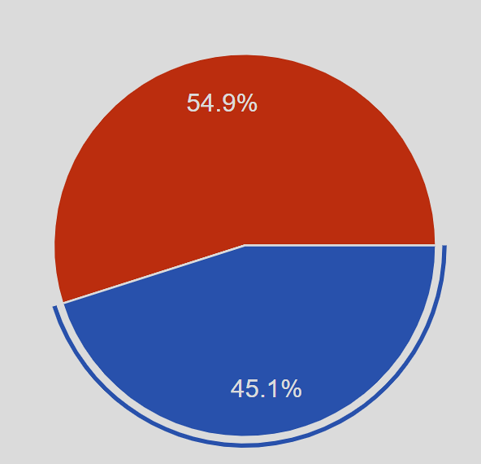
Study of conducted surveys
Do you own or operate any of the following ?
Shops
Manufacturing Unit

Slide 11
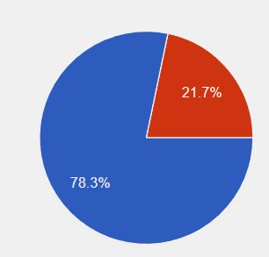
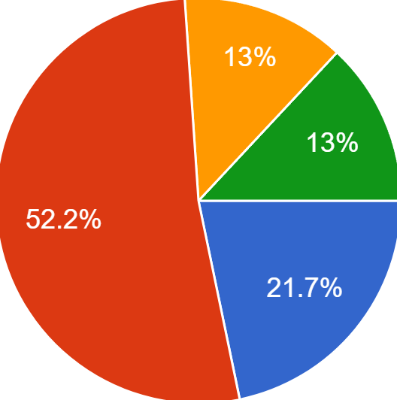
Study of conducted surveys-shop side
Are you open to using a new platform to streamline operations?
How many manufacturers do you currently work with?
yes
No
1-5
6-10
10-15
More than 20

Slide 12
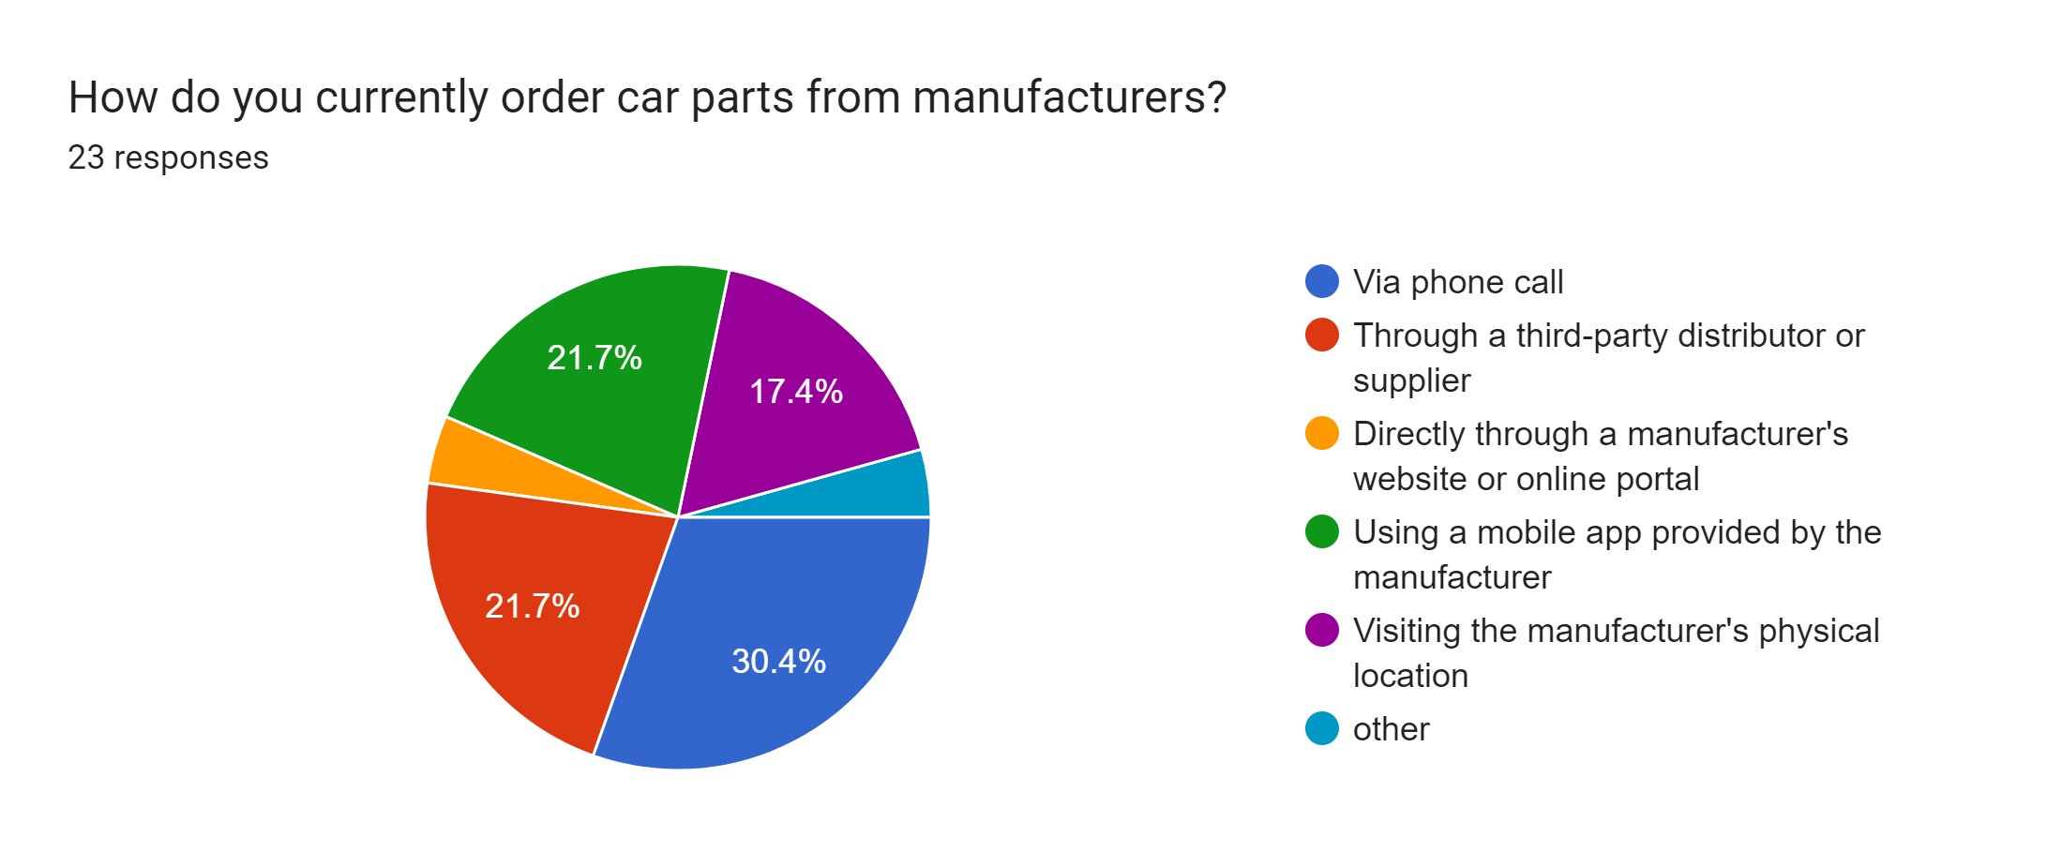
Study of conducted surveys-shop side
How do you currently order car parts from manufacturers ?
Via phonecall
Through a third-party distributor or supplier
Directly through a manufacturer’s website or online portal
WhatsApp
Visiting the manufacturer's physical location
other
4.3%
4.3%

Slide 13
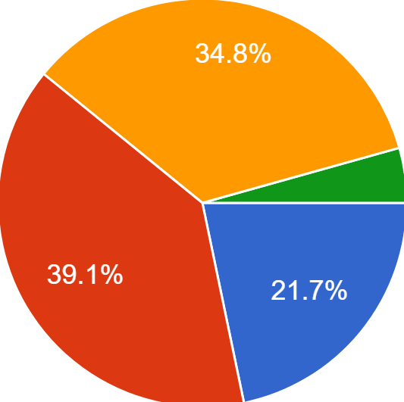
Study of conducted surveys-shop side
How long have you been in the car parts retail business ?
Less than 1 year
1-5 years
6-10 years
More than 15 years
4.3%

Slide 14
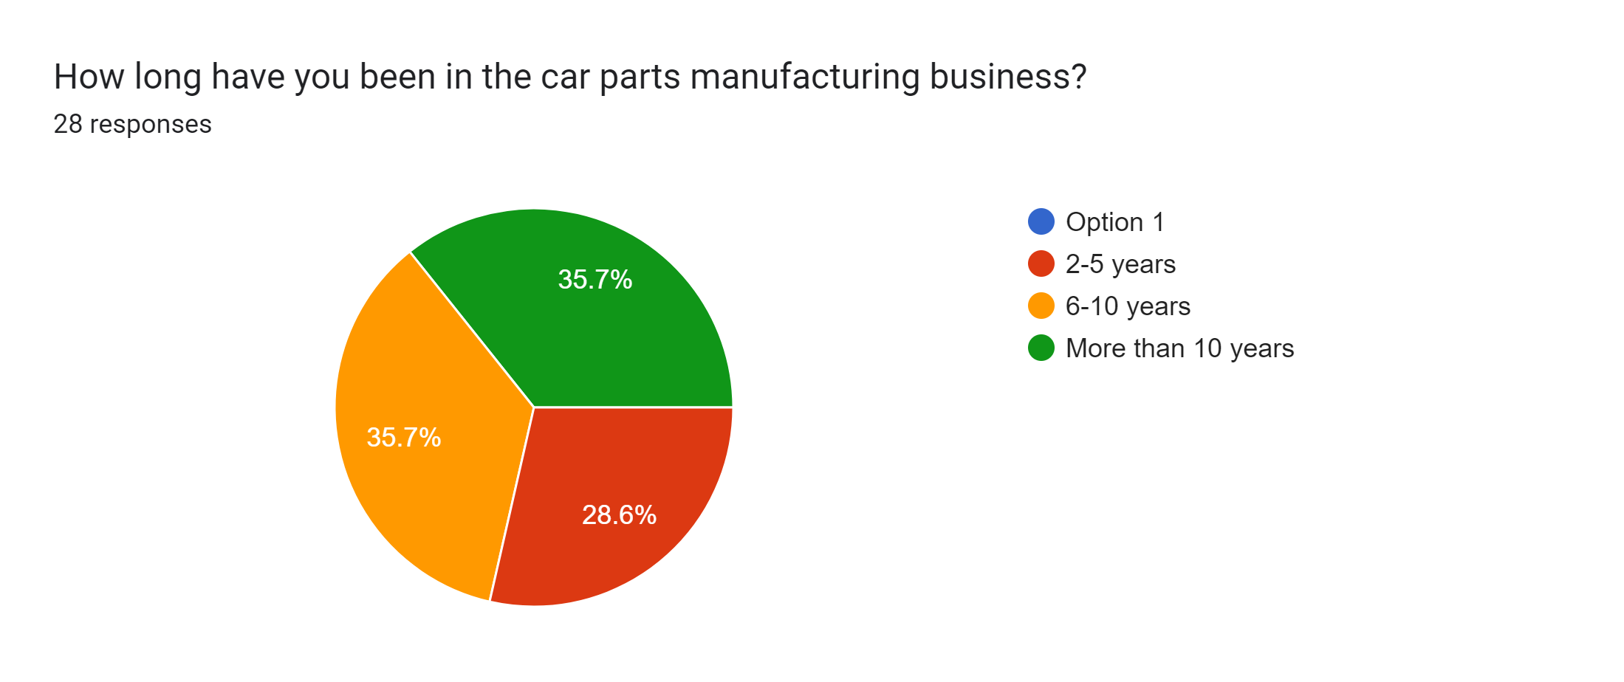
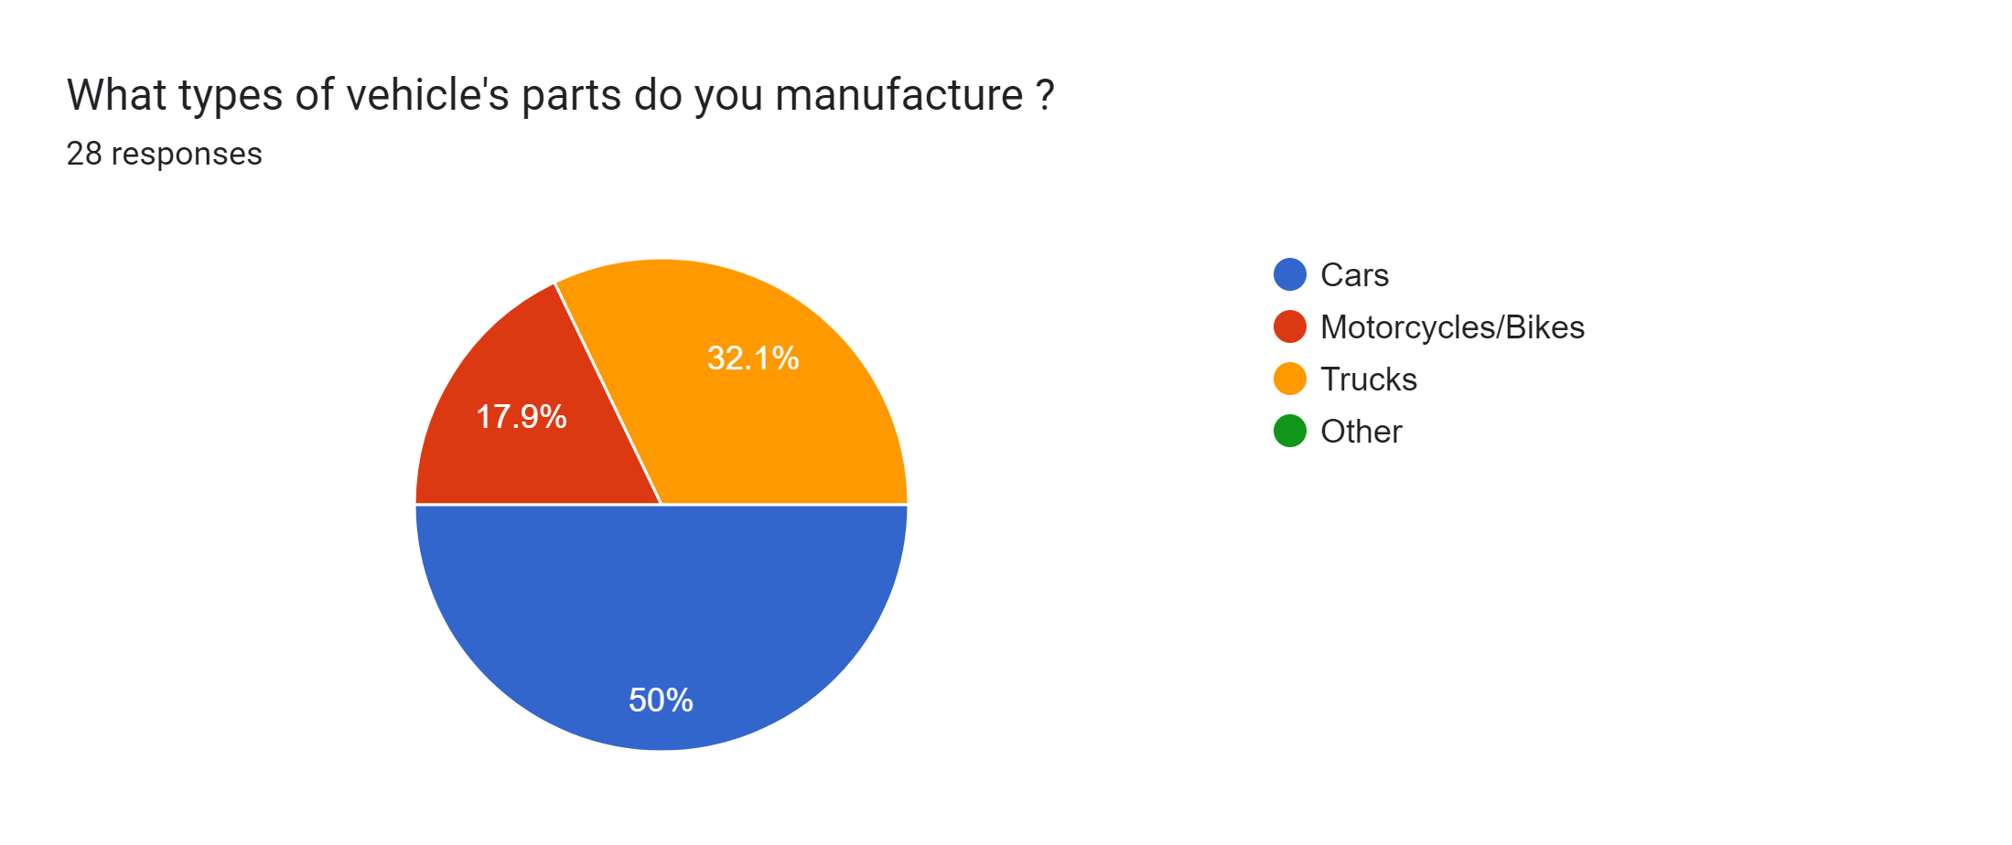
Study of conducted surveys- manufacturers
How long have you been in the car parts manufacturing business ?
What types of vehicle's parts do you manufacture ?
2-5 years
6-10 years
More than 10 years
Cars
Motorcycles(Bike)
Trucks

Slide 15
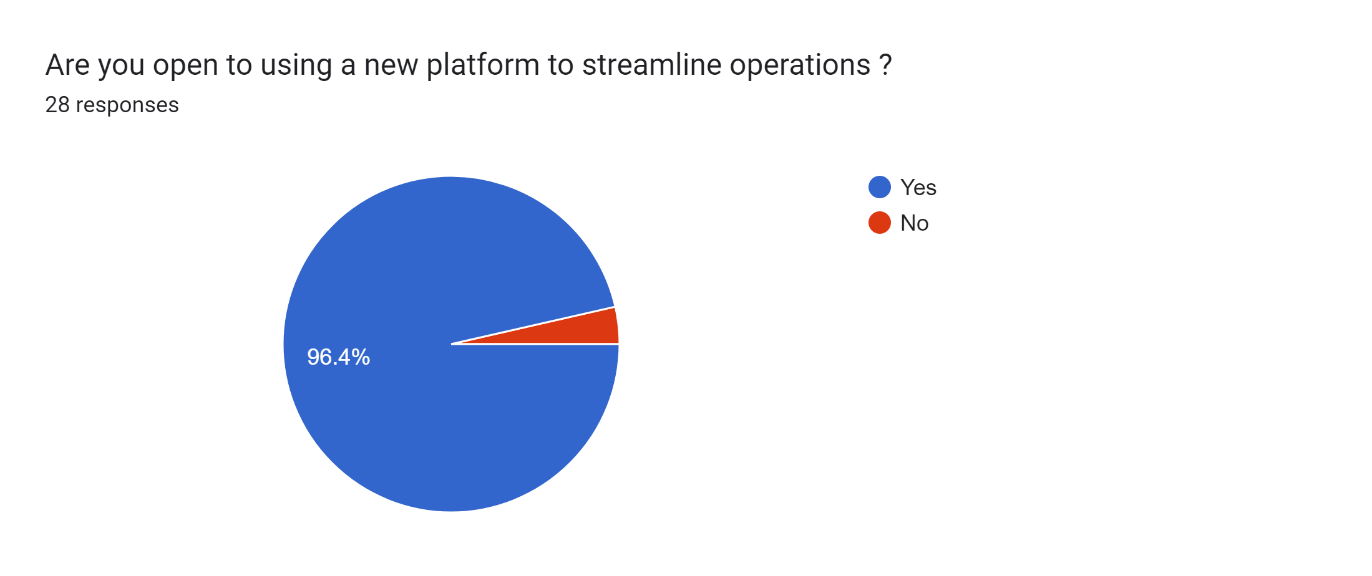
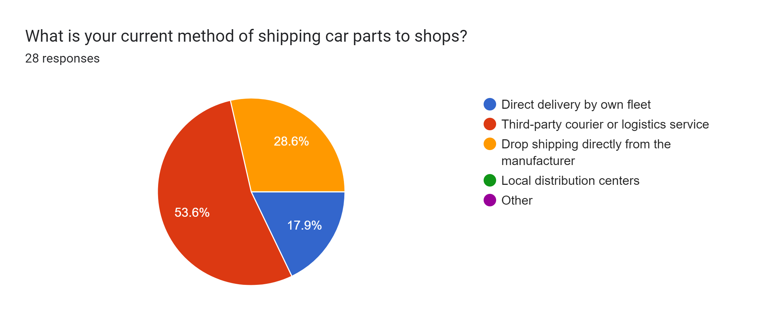
Study of conducted surveys- manufacturers
Are you open to using a new platform to streamline operations ?
What is your current method of shipping car parts to shops?
Direct delivery by own fleet
Third-party courier or logistics service
Drop shipping directly from the manufacturer
yes
No

Slide 16
Expected Outcome
Cost Savings for Shops
Competitive Advantage for Shops
Increased Market Transparency
Stronger Community and Collaboration
Enhanced Supplier Relationships
Expanded Market Access for Manufacturers

Slide 17
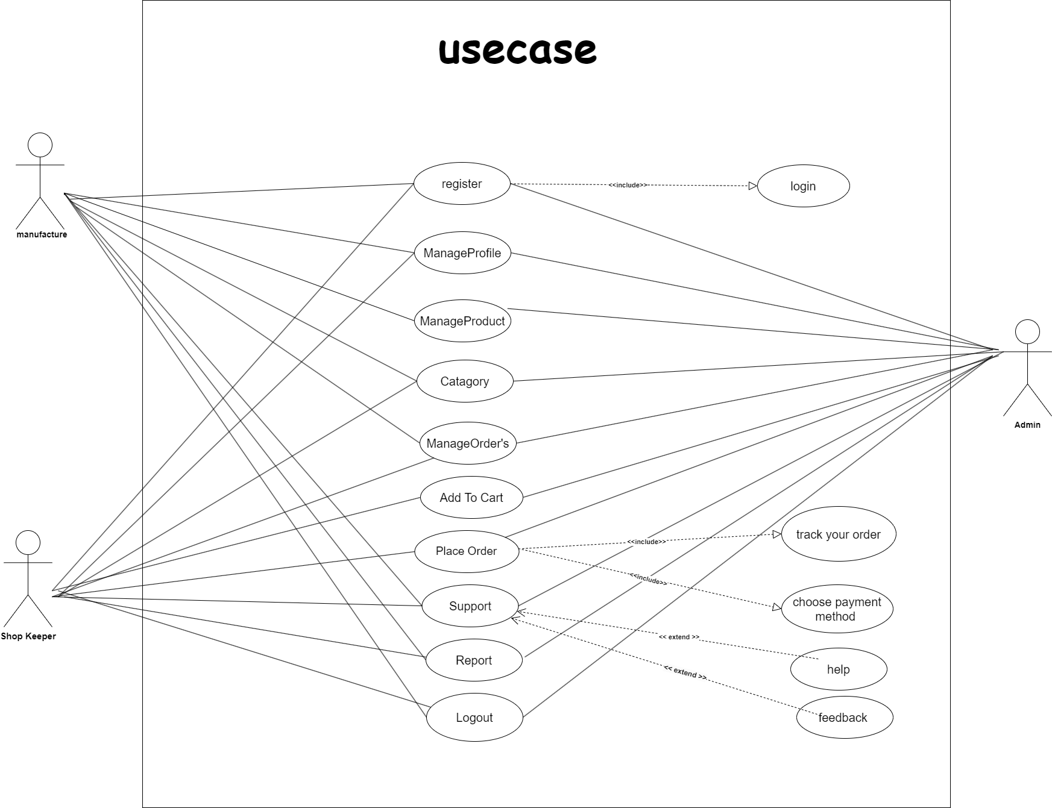
Diagram’s
Use Case

Slide 18
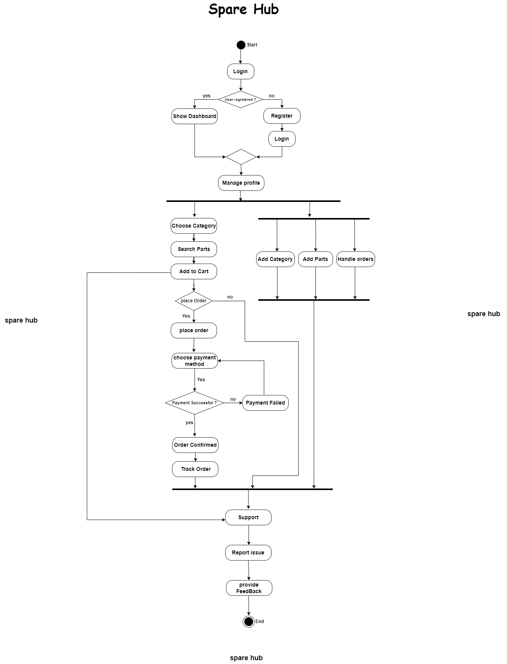
Diagram’s
Activity diagram

Slide 19
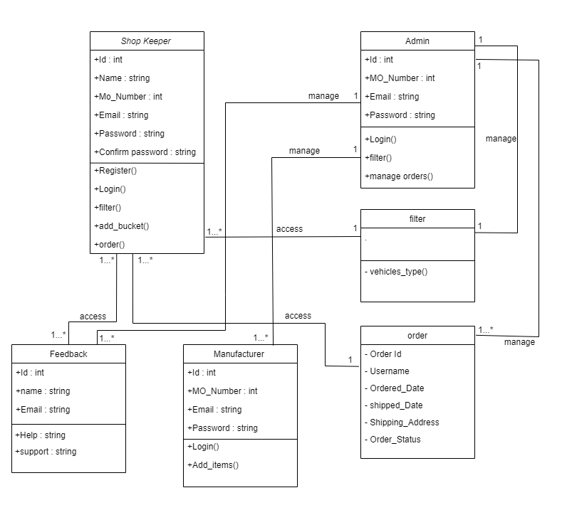
Diagram’s
Class diagram

Slide 20
Data Dictionary
Manufacture Table
Field | Data Type | Size | Description | Constraint
id | int | 20 | Unique identifier for the manufacturer | Primary Key
company_name | varchar | 255 | Name of the manufacturing company | NOT NULL
contact_name | varchar | 255 | Contact person for the manufacturer | NOT NULL
phone | varchar | 20 | Phone number for the manufacturer | NOT NULL
gst | varchar | 50 | GST number for the manufacturer | NOT NULL
address | longtext | - | Address of the manufacturer | NOT NULL
city | varchar | 100 | City of the manufacturer | NOT NULL
state | varchar | 100 | State of the manufacturer | NOT NULL
country | varchar | 100 | Country of the manufacturer | NOT NULL
website | varchar | 200 | Website URL for the manufacturer (optional) | NULL
product_categories | longtext | 200 | Categories of products manufactured | NOT NULL
logo | varchar | 200 | Path to the manufacturer logo | NULL
terms_accepted | tinyint | 1 | Indicates if terms are accepted (0 or 1) | NOT NULL
created_at | datetime | 6 | Timestamp when the manufacturer was created | NOT NULL
updated_at | datetime | 6 | Timestamp when the manufacturer was last updated | NOT NULL

Slide 21
Data Dictionary
Shop Table
Field | Data Type | Size | Description | Constraint
id | bigint | 20 | Unique identifier for the shop | Primary Key
shop_name | varchar | 255 | Name of the shop | NOT NULL
contact_name | varchar | 255 | Contact person for the shop | NOT NULL
phone | varchar | 20 | Phone number for the shop | NOT NULL
gst | varchar | 50 | GST number for the shop | NOT NULL
address | longtext | - | Address of the shop | NOT NULL
city | varchar | 100 | City of the shop | NOT NULL
state | varchar | 100 | State of the shop | NOT NULL
country | varchar | 100 | Country of the shop | NOT NULL
website | varchar | 200 | Website URL for the shop (optional) | NULL
business_type | varchar | 50 | Type of business for the shop (optional) | NULL
logo | varchar | 200 | Path to the shop logo | NULL
license | varchar | 200 | Path to the shop license | NULL
terms_accepted | tinyint | 1 | Indicates if terms are accepted (0 or 1) | NOT NULL
created_at | datetime | 6 | Timestamp when the shop was created | NOT NULL
updated_at | datetime | 6 | Timestamp when the shop was last updated | NOT NULL

Slide 22
Data Dictionary
Products_Brand
Field | Data Type | Size | Description | Constraint
id | bigint | 20 | Unique identifier for the brand | Primary Key
name | varchar | 255 | Name of the brand | NOT NULL, UNIQUE
logo | varchar | 100 | Path to the brand logo | NULL
description | longtext | - | Description of the brand | NOT NULL
is_active | tinyint | 1 | Indicates if the brand is active (0 or 1) | NOT NULL
created_at | datetime | 6 | Timestamp when the brand was created | NOT NULL
updated_at | datetime | 6 | Timestamp when the brand was last updated | NOT NULL

Slide 23
Data Dictionary
Products_category
Field | Data Type | Size | Description | Constraint
id | bigint | 20 | Unique identifier for the category | Primary Key
name | varchar | 255 | Name of the category | NOT NULL, UNIQUE
slug | varchar | 255 | URL-friendly identifier for the category | NOT NULL, UNIQUE
image | varchar | 100 | Path to the category image | NULL
is_active | tinyint | 1 | Indicates if the category is active (0 or 1) | NOT NULL
created_at | datetime | 6 | Timestamp when the category was created | NOT NULL
updated_at | datetime | 6 | Timestamp when the category was last updated | NOT NULL
Field | Data Type | Size | Description | Constraint

Slide 24
Data Dictionary
Products_Product
Field | Data Type | Size | Description | Constraint
id | bigint | 20 | Unique identifier for the product | Primary Key
name | varchar | 255 | Name of the product | NOT NULL
description | longtext | - | Detailed description of the product | NOT NULL
sku | varchar | 100 | Stock Keeping Unit (unique identifier for inventory) | NOT NULL, UNIQUE
price | decimal | 10,2 | Price of the product | NOT NULL
discount | decimal | 5,2 | Discount percentage for the product | NOT NULL
stock_quantity | int | 10 | Available stock quantity (unsigned) | NOT NULL, CHECK (>= 0)
min_order_quantity | int | 10 | Minimum order quantity (unsigned) | NOT NULL, CHECK (>= 0)
max_order_quantity | int | 10 | Maximum order quantity (unsigned, optional) | NULL, CHECK (>= 0)
weight | decimal | 10,2 | Weight of the product | NOT NULL
dimensions | varchar | 100 | Dimensions of the product (e.g., length x width x height) | NOT NULL
material | varchar | 255 | Material used in the product | NOT NULL
color | varchar | 100 | Color of the product | NOT NULL
technical_specification_pdf | varchar | 100 | Path to technical specification PDF | NULL
installation_guide_pdf | varchar | 100 | Path to installation guide PDF | NULL
shipping_cost | decimal | 10,2 | Cost of shipping the product | NOT NULL
shipping_time | varchar | 100 | Estimated shipping time | NOT NULL
origin_country | varchar | 100 | Country of origin for the product | NOT NULL
is_active | tinyint | 1 | Indicates if the product is active (0 or 1) | NOT NULL
is_featured | tinyint | 1 | Indicates if the product is featured (0 or 1) | NOT NULL
is_approved | tinyint | 1 | Indicates if the product is approved (0 or 1) | NOT NULL
created_at | datetime | 6 | Timestamp when the product was created | NOT NULL

Slide 25
Data Dictionary
Products_Subcategory
Field | Data Type | Size | Description | Constraint
id | bigint | 20 | Unique identifier for the subcategory | Primary Key
name | varchar | 255 | Name of the subcategory | NOT NULL
slug | varchar | 255 | URL-friendly identifier for the subcategory | NOT NULL
image | varchar | 100 | Path to the subcategory image | NULL
is_active | tinyint | 1 | Indicates if the subcategory is active (0 or 1) | NOT NULL
created_at | datetime | 6 | Timestamp when the subcategory was created | NOT NULL
updated_at | datetime | 6 | Timestamp when the subcategory was last updated | NOT NULL
category_id | bigint | 20 | ID of the associated category | Foreign Key (products_category.id), UNIQUE with name

Slide 26
Data Dictionary
Orders_Orderpayment
Field | Data Type | Size | Description | Constraint
id | bigint | 20 | Unique identifier for the payment | Primary Key
method | varchar | 20 | Payment method (e.g., COD, card) | NOT NULL
status | varchar | 20 | Payment status (e.g., pending, completed) | NOT NULL
amount | decimal | 10,2 | Payment amount | NOT NULL
transaction_id | varchar | 255 | Transaction ID (optional) | NULL
timestamp | datetime | 6 | Timestamp of the payment | NOT NULL
metadata | longtext | - | Additional payment metadata (JSON) | NULL, CHECK (json_valid)

Slide 27
Data Dictionary
Orders_Order (Includes Add to Cart and Order)
Field | Data Type | Size | Description | Constraint
id | bigint | 20 | Unique identifier for the order | Primary Key
shop_name | varchar | 255 | Name of the shop processing the order | NOT NULL
items | longtext | - | JSON array of cart items (product_id, quantity, price) | NOT NULL, CHECK (json_valid)
status | varchar | 20 | Order status (e.g., pending, shipped) | NOT NULL
subtotal | decimal | 10,2 | Subtotal of the order (before tax and shipping) | NOT NULL
tax | decimal | 10,2 | Tax amount for the order | NOT NULL
shipping_cost | decimal | 10,2 | Shipping cost for the order | NOT NULL
total | decimal | 10,2 | Total amount for the order (subtotal + tax + shipping) | NOT NULL
created_at | datetime | 6 | Timestamp when the order was created | NOT NULL
updated_at | datetime | 6 | Timestamp when the order was last updated | NOT NULL
metadata | longtext | - | Additional order metadata (JSON, e.g., checkout timestamp) | NULL, CHECK (json_valid)
user_id | int | 11 | ID of the user who placed the order | Foreign Key (users_user.id)
billing_address_id | bigint | 20 | ID of the billing address | Foreign Key (orders_orderaddress.id), NULL
shipping_address_id | bigint | 20 | ID of the shipping address | Foreign Key (orders_orderaddress.id)
payment_id | bigint | 20 | ID of the associated payment | Foreign Key (orders_orderpayment.id), UNIQUE

Slide 28
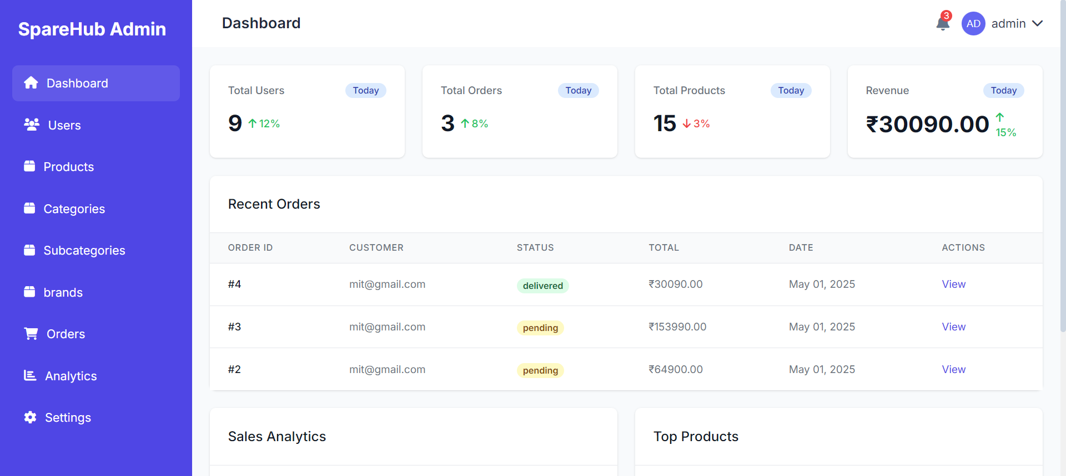

Slide 29
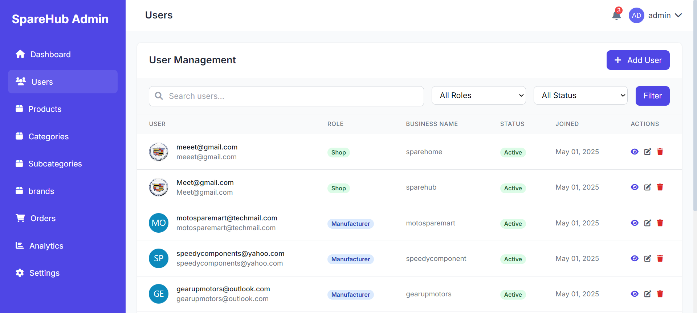

Slide 30
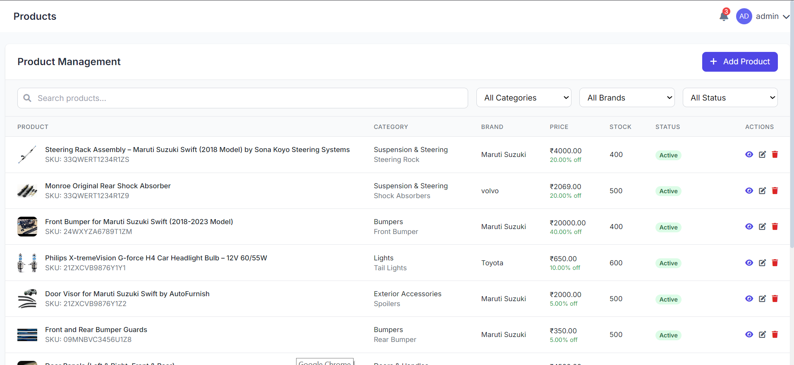

Slide 31
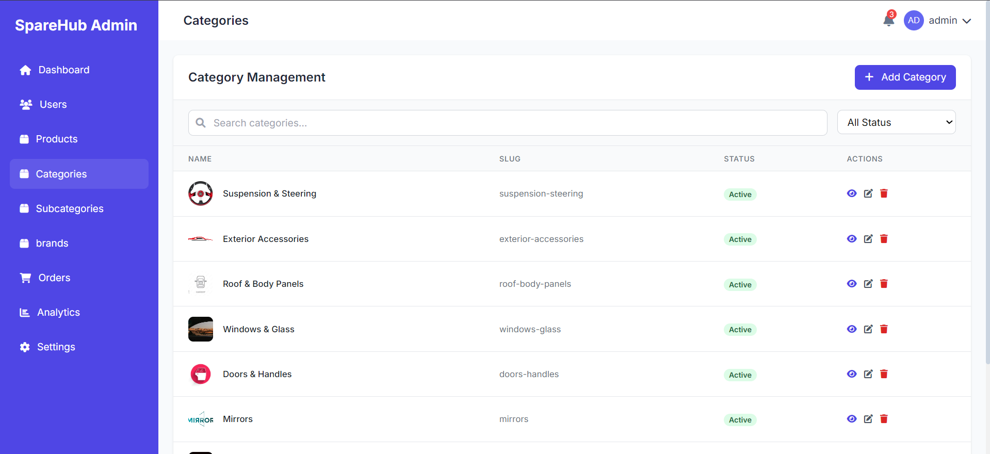

Slide 32
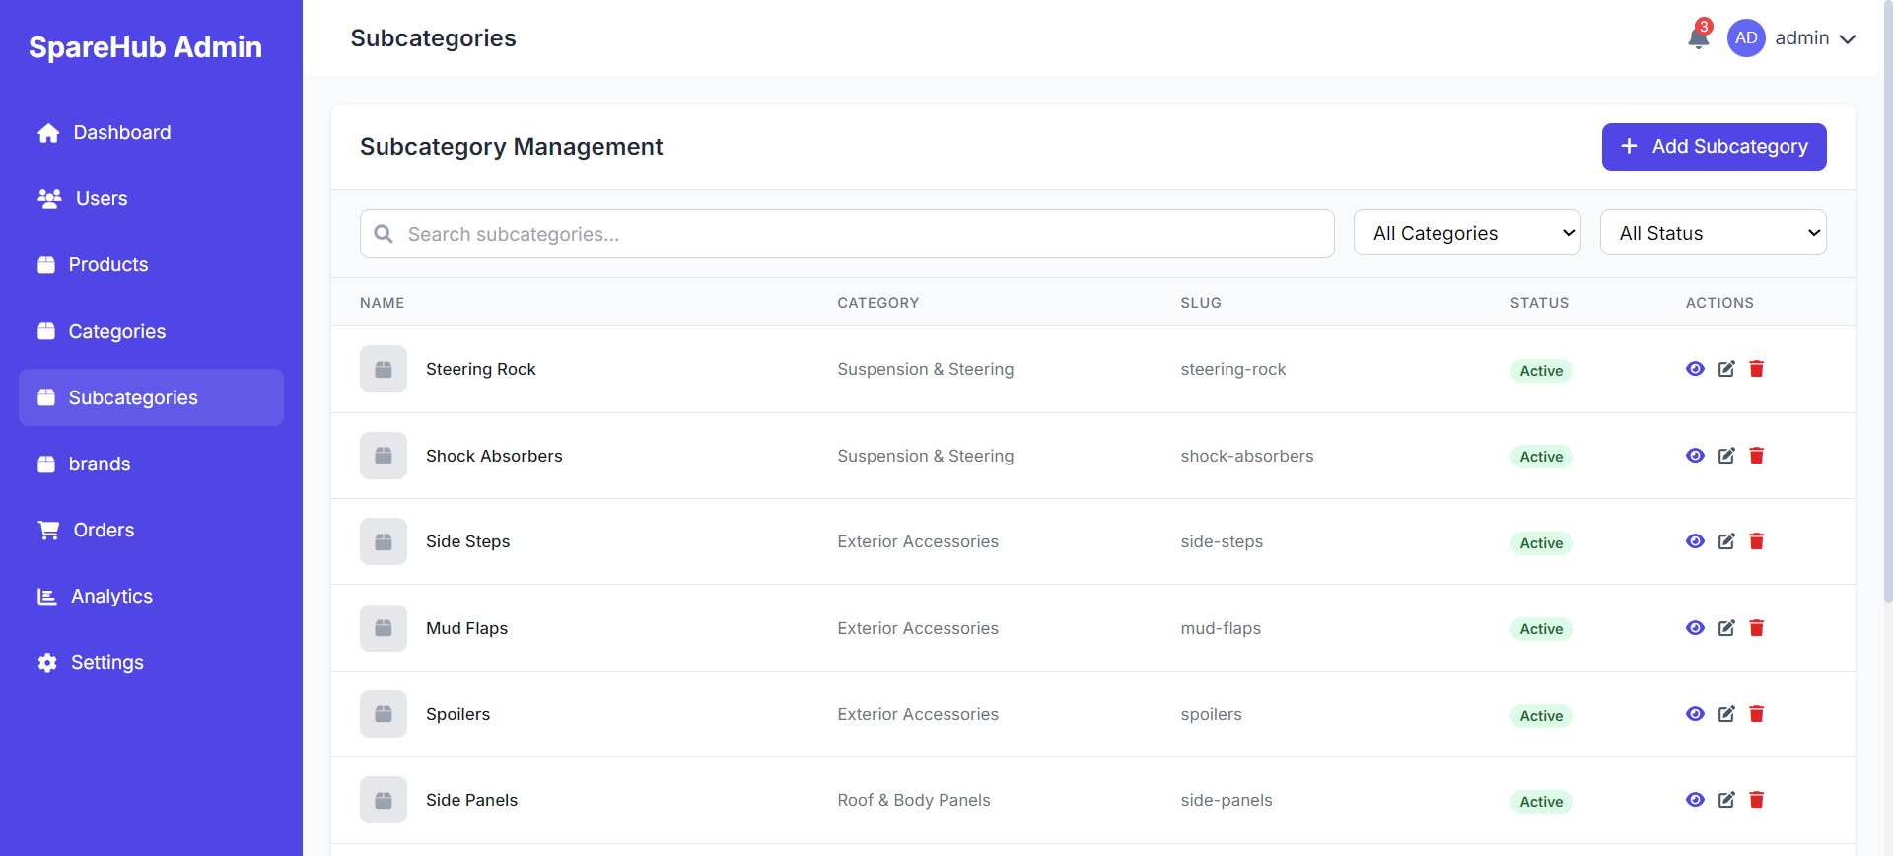

Slide 33
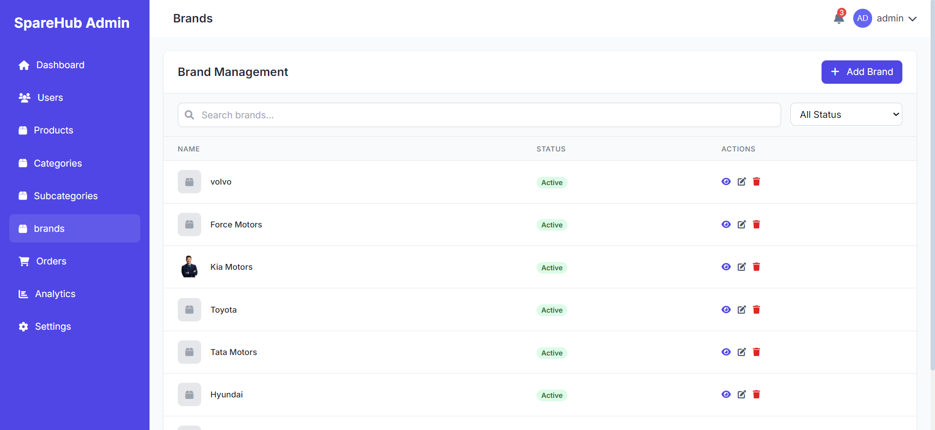

Slide 34
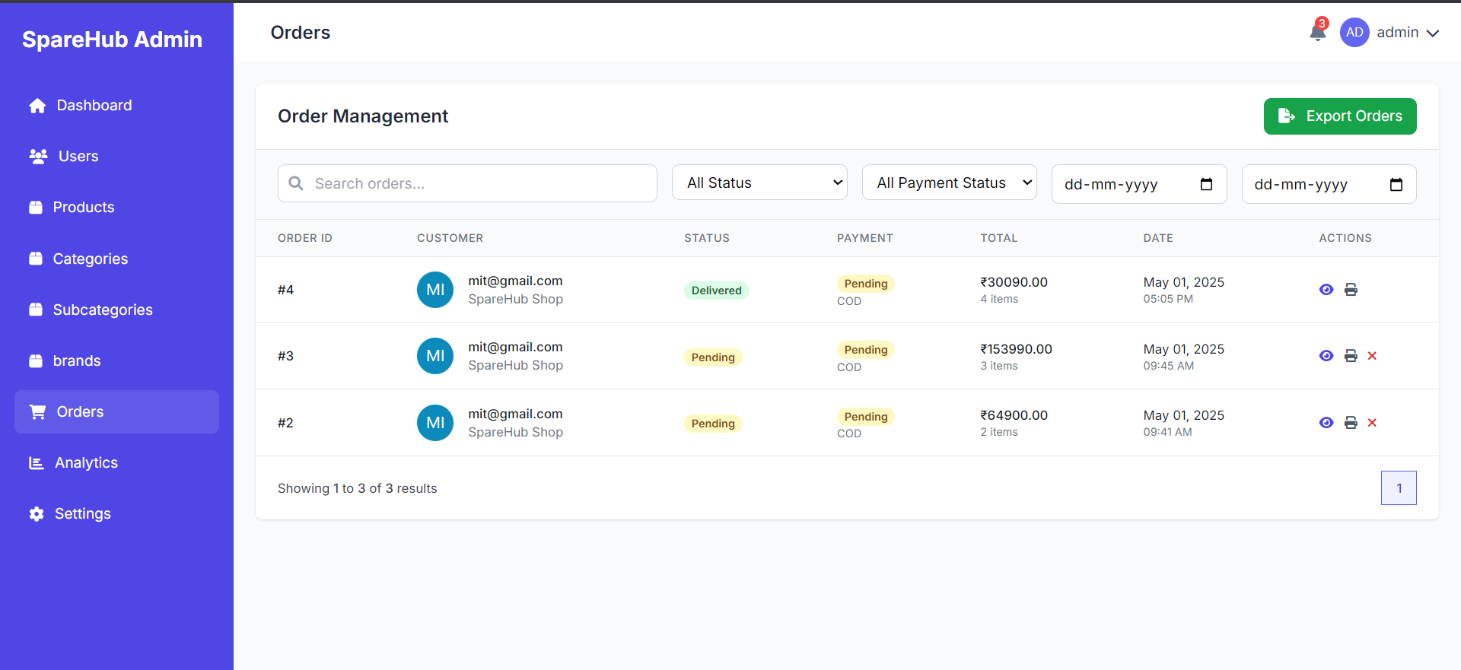

Slide 35
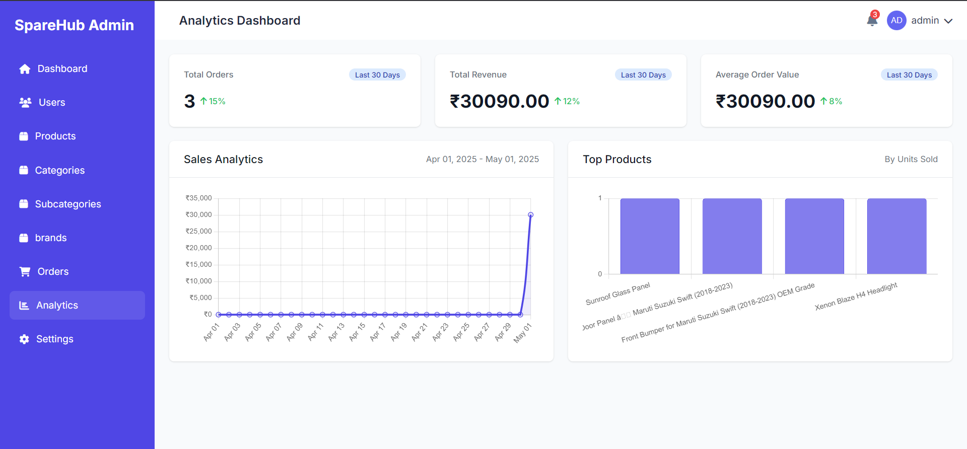

Slide 36
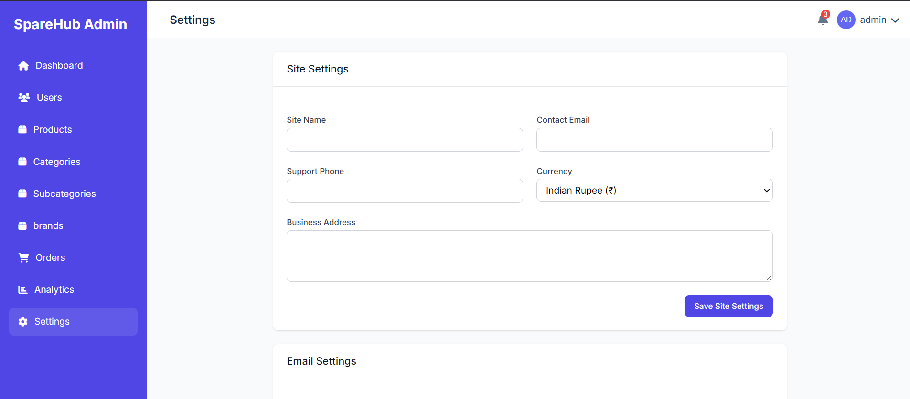

Slide 37
Login info.

Slide 38

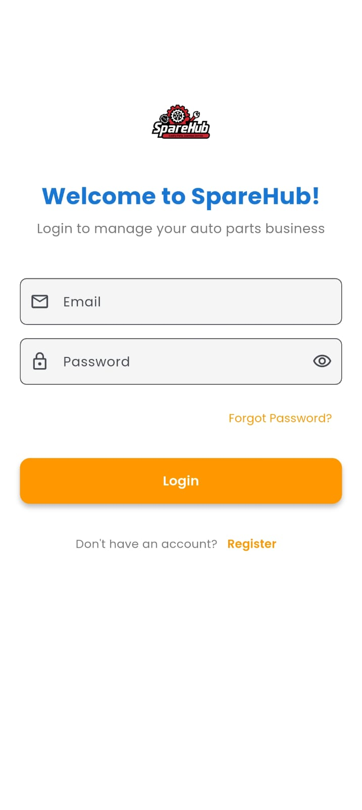
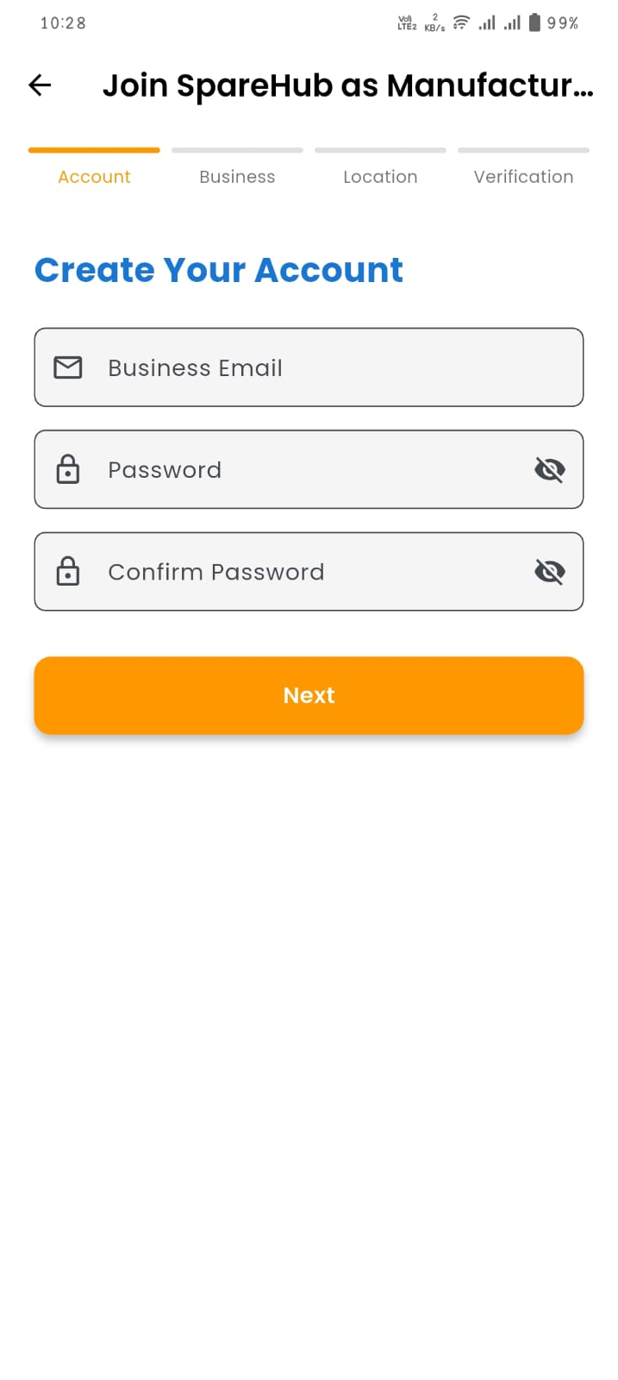
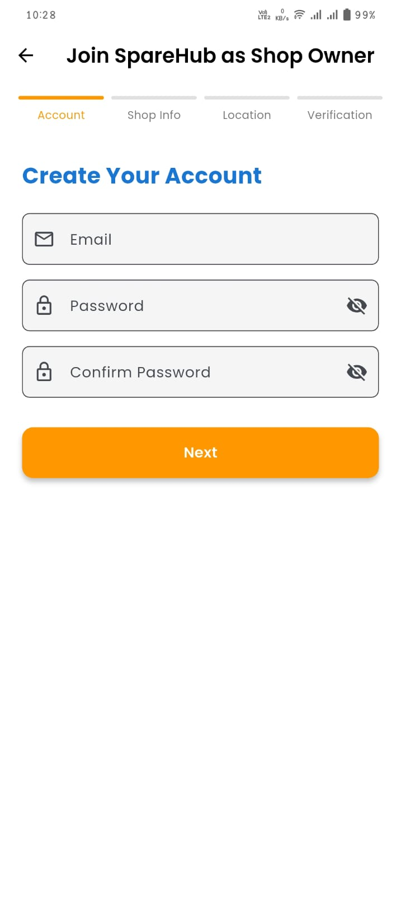

Slide 39
Shopkeeper

Slide 40
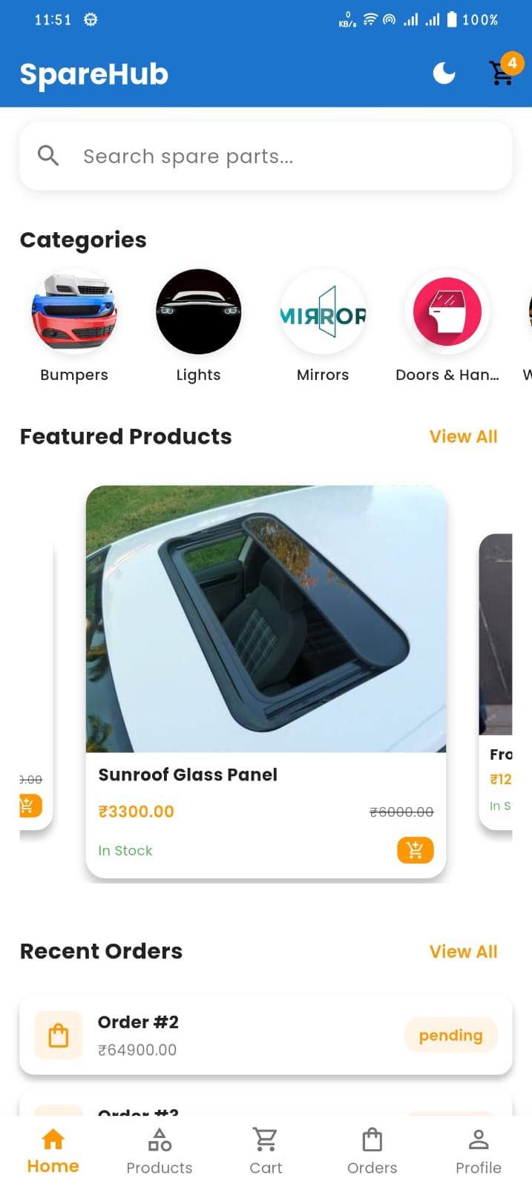
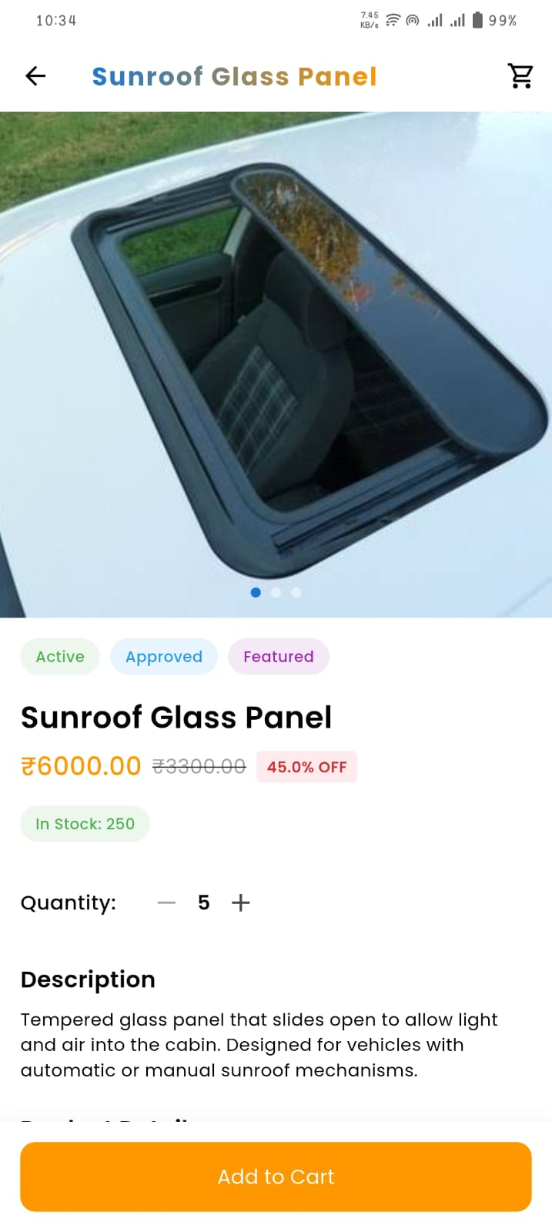
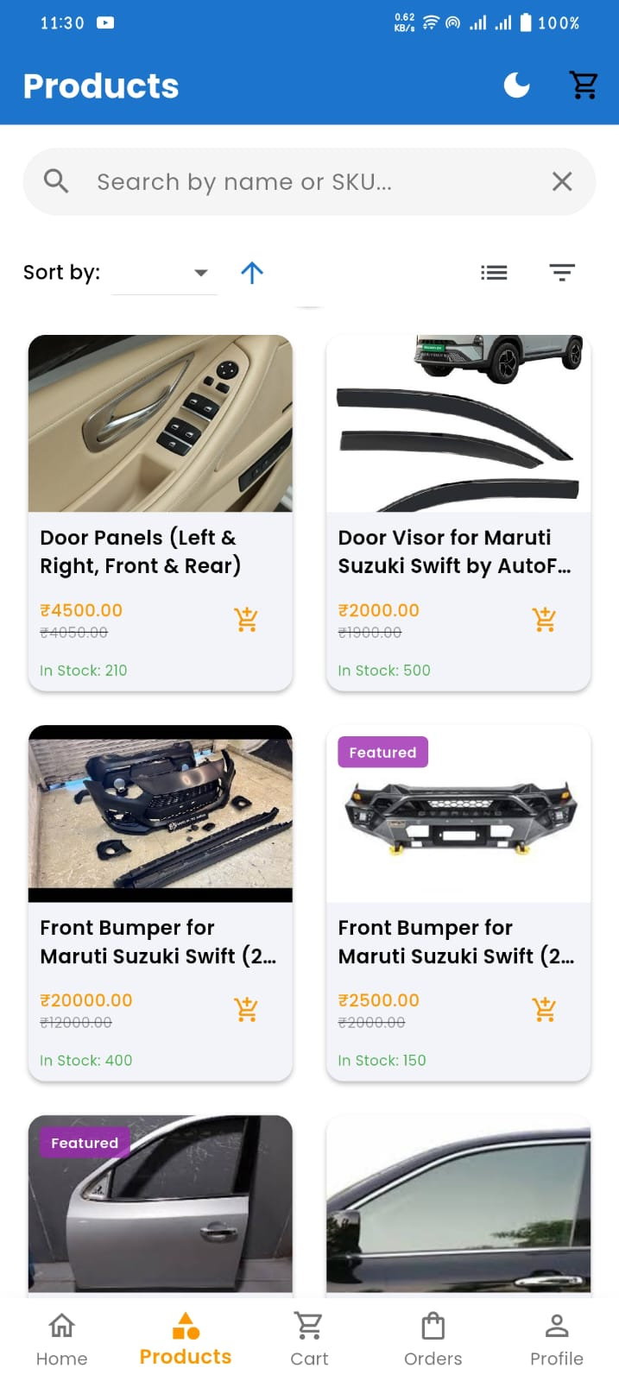
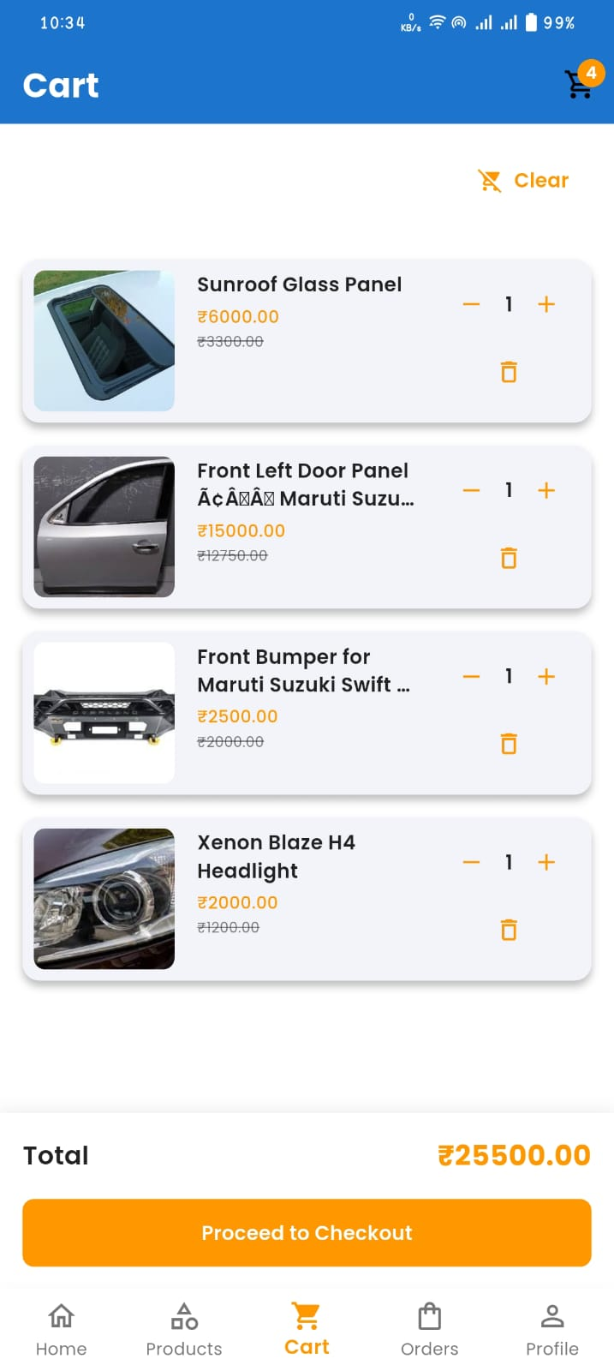

Slide 41
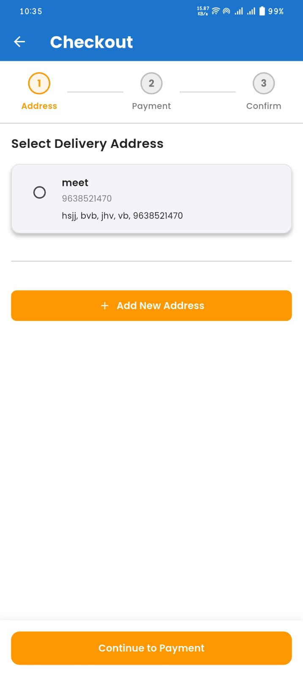
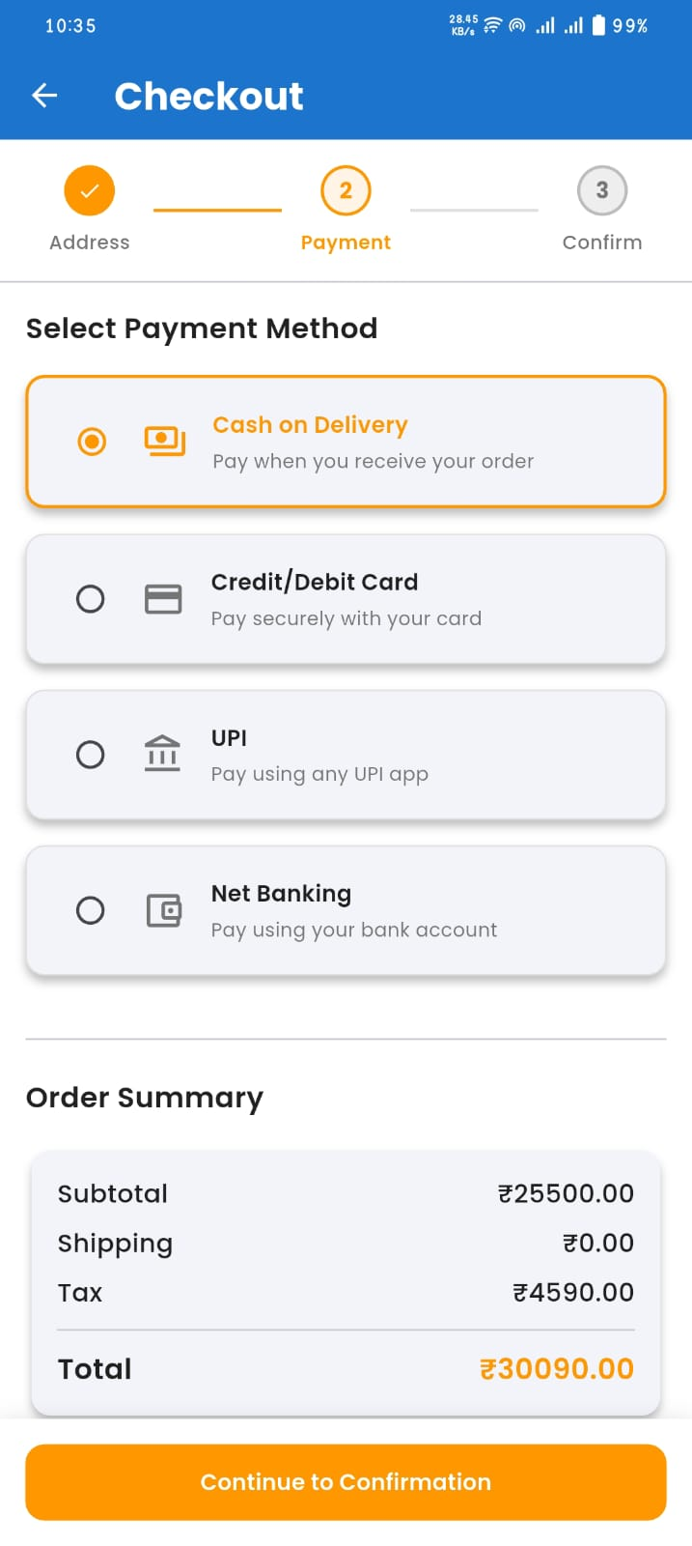
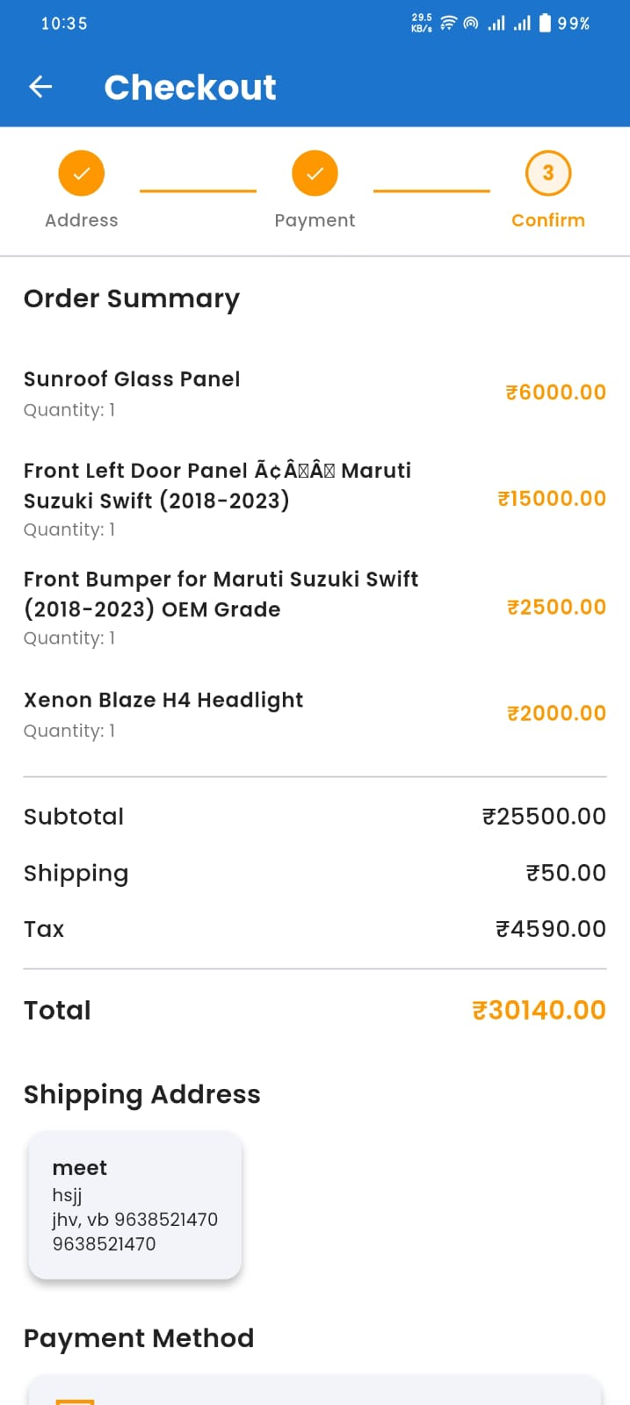
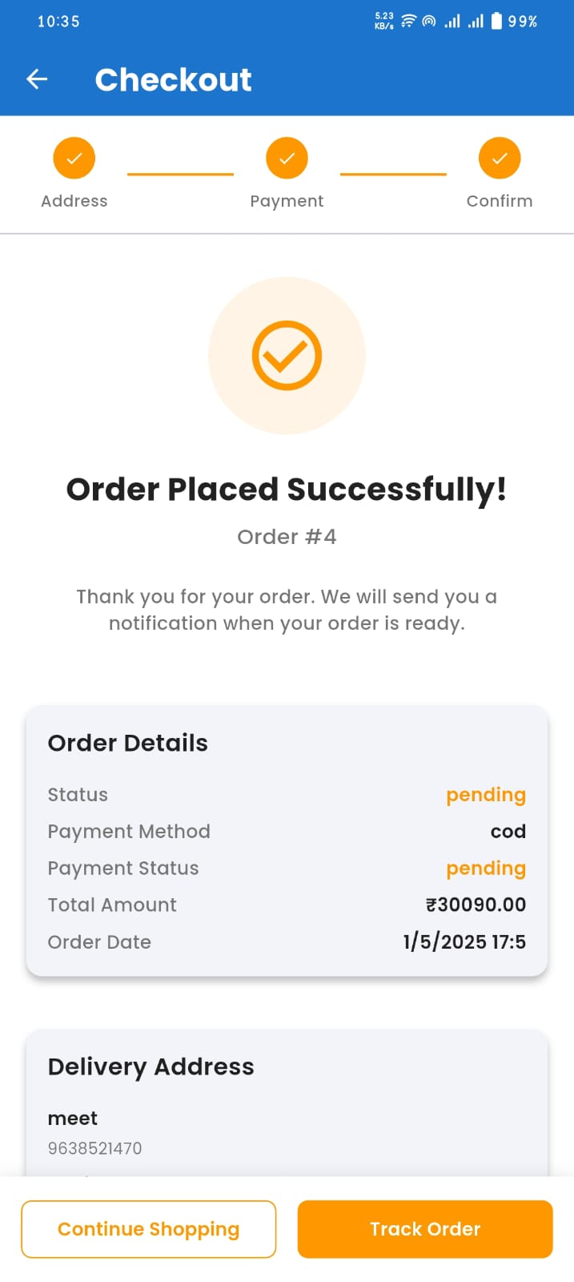

Slide 42
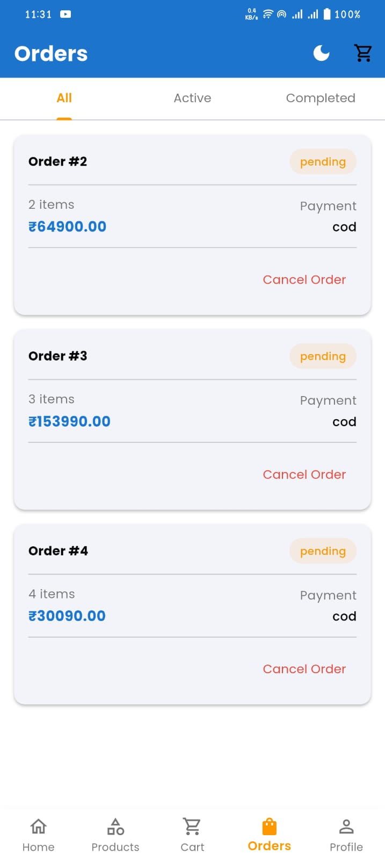
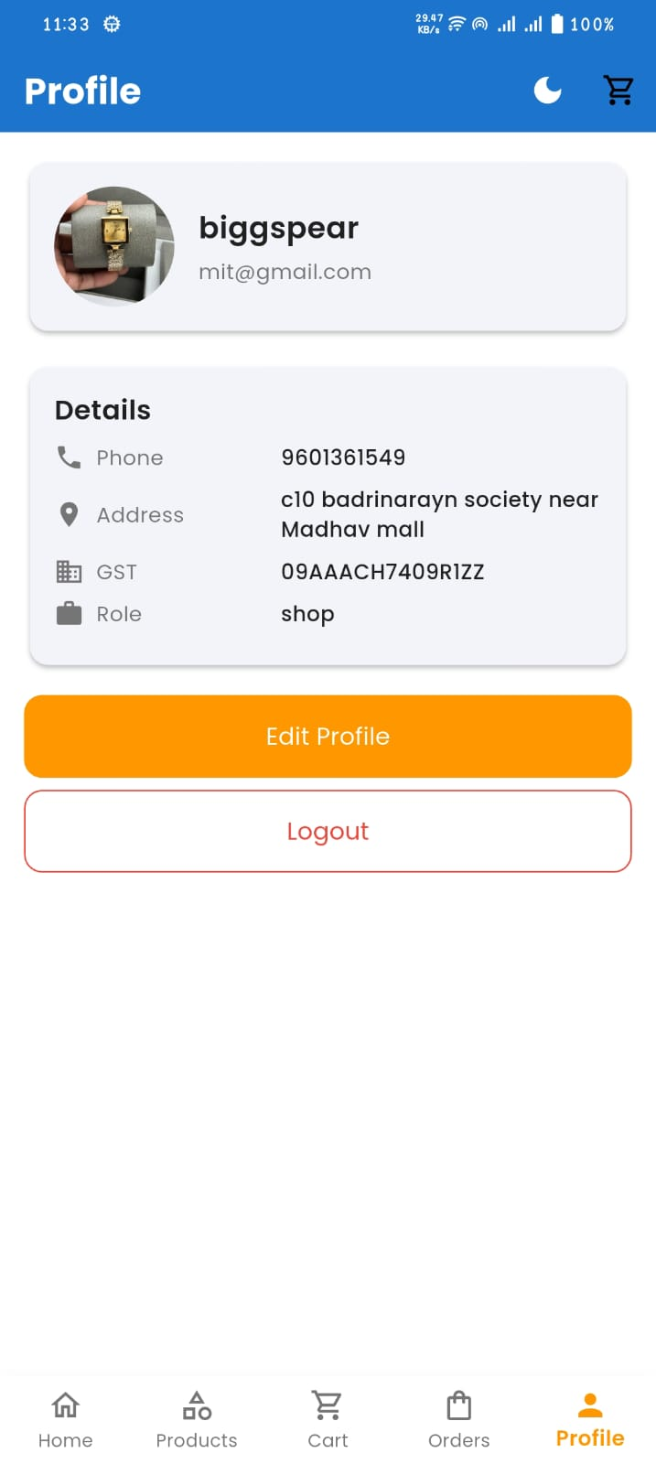

Slide 43
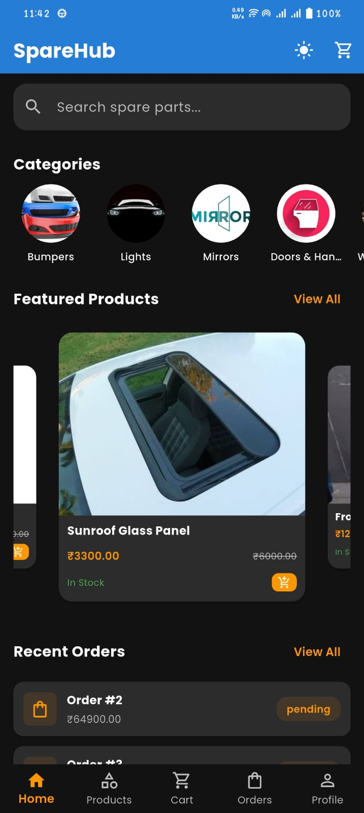
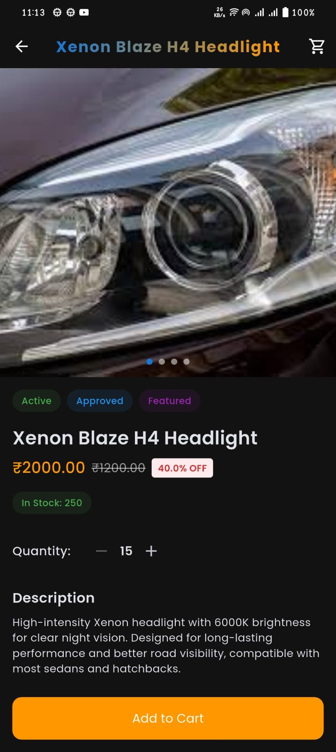
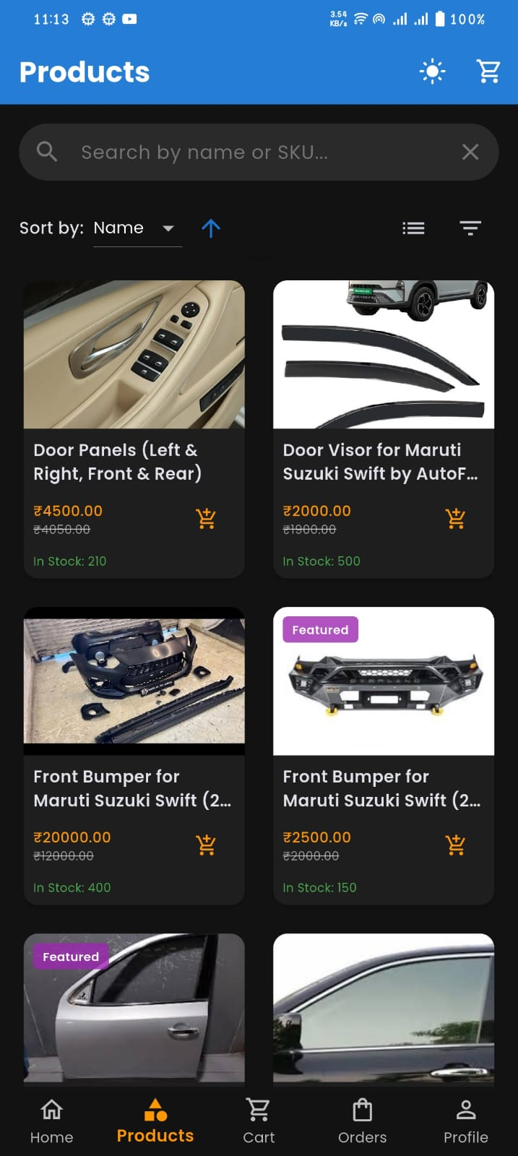
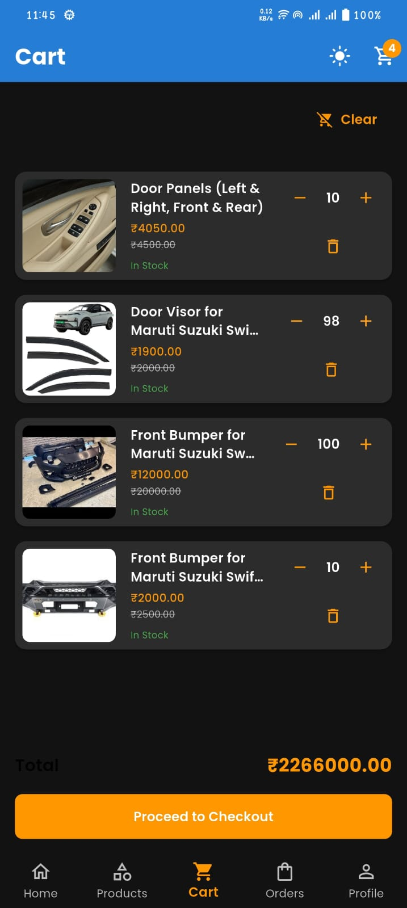

Slide 44
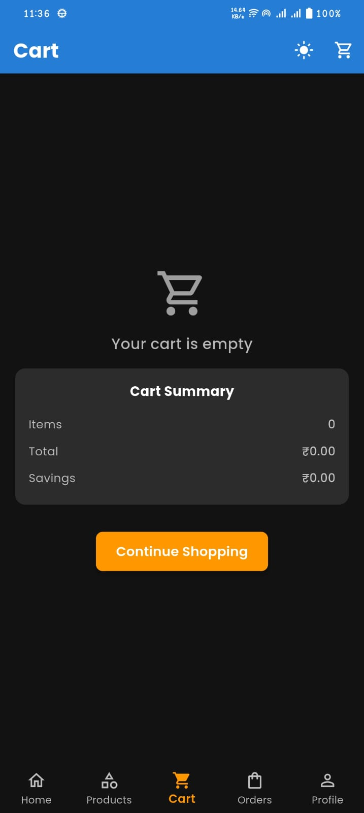
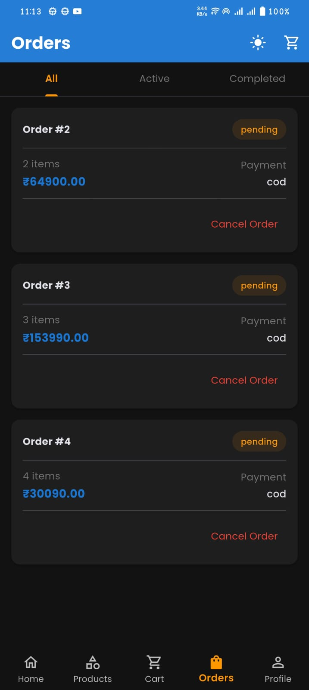
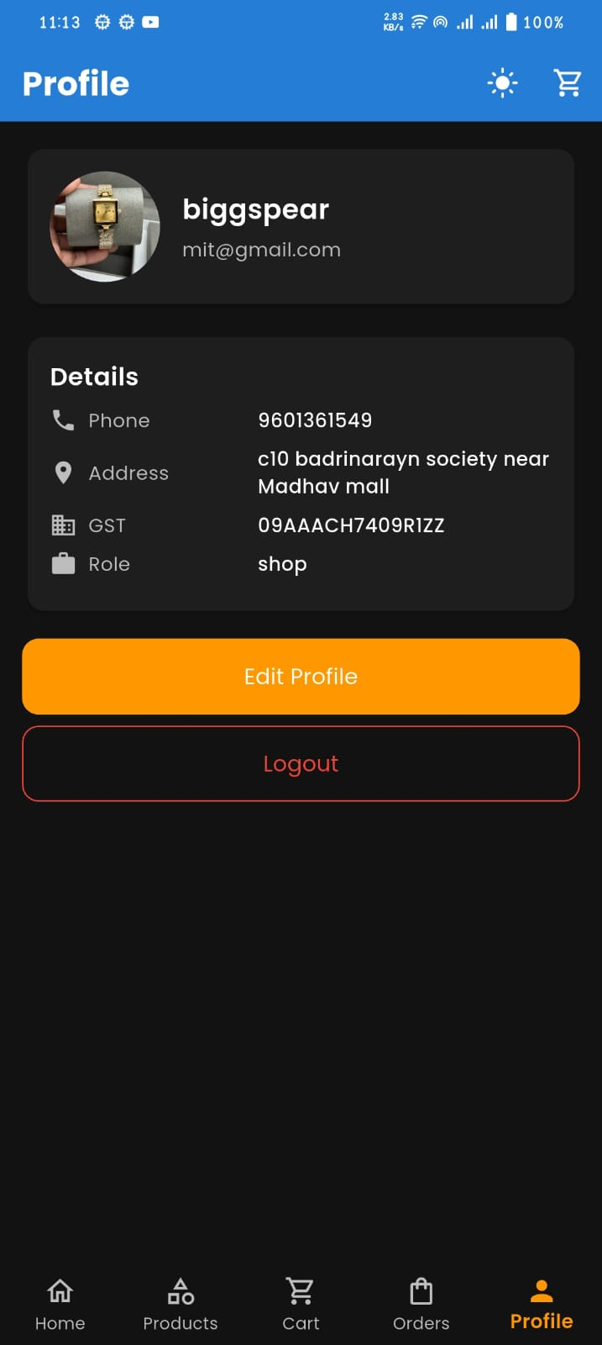

Slide 45
Manufacturer

Slide 46
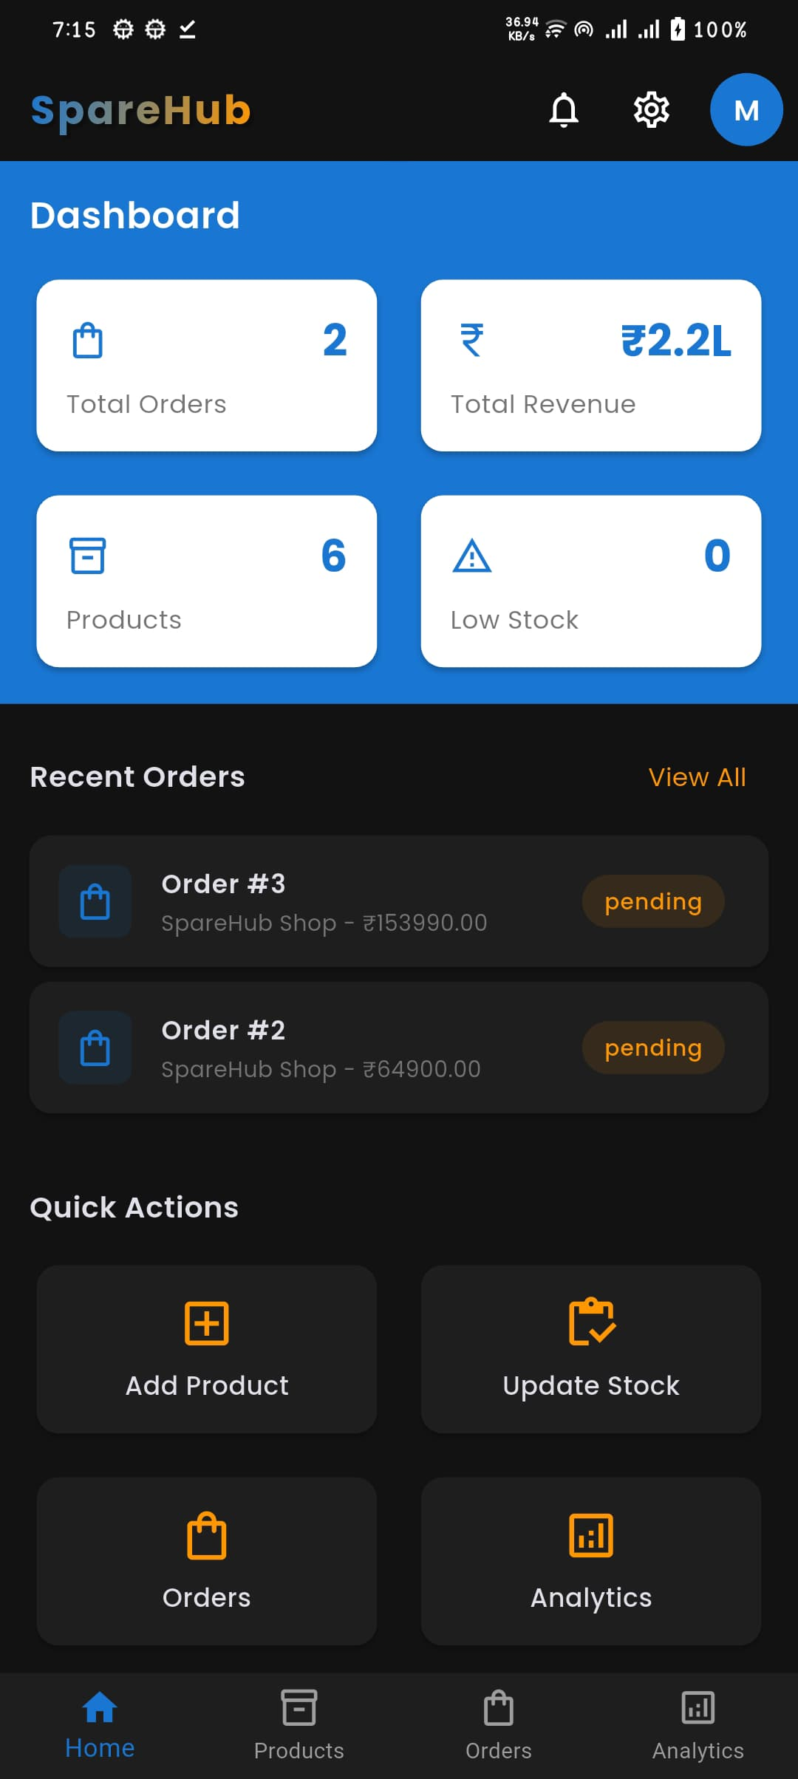
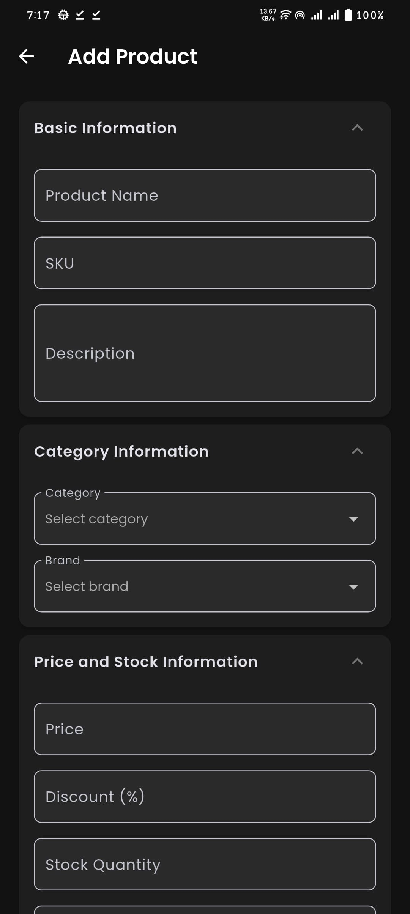
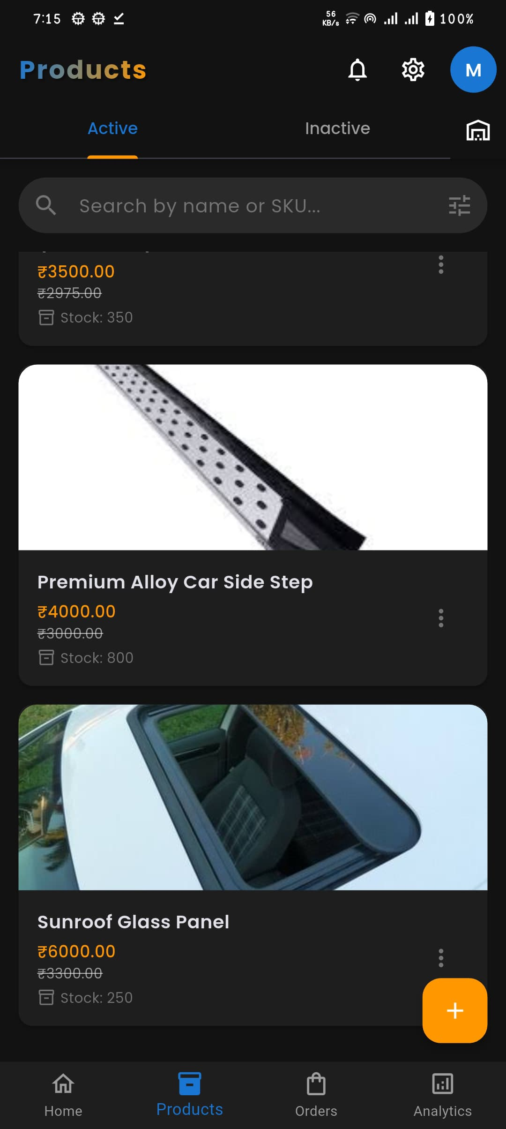
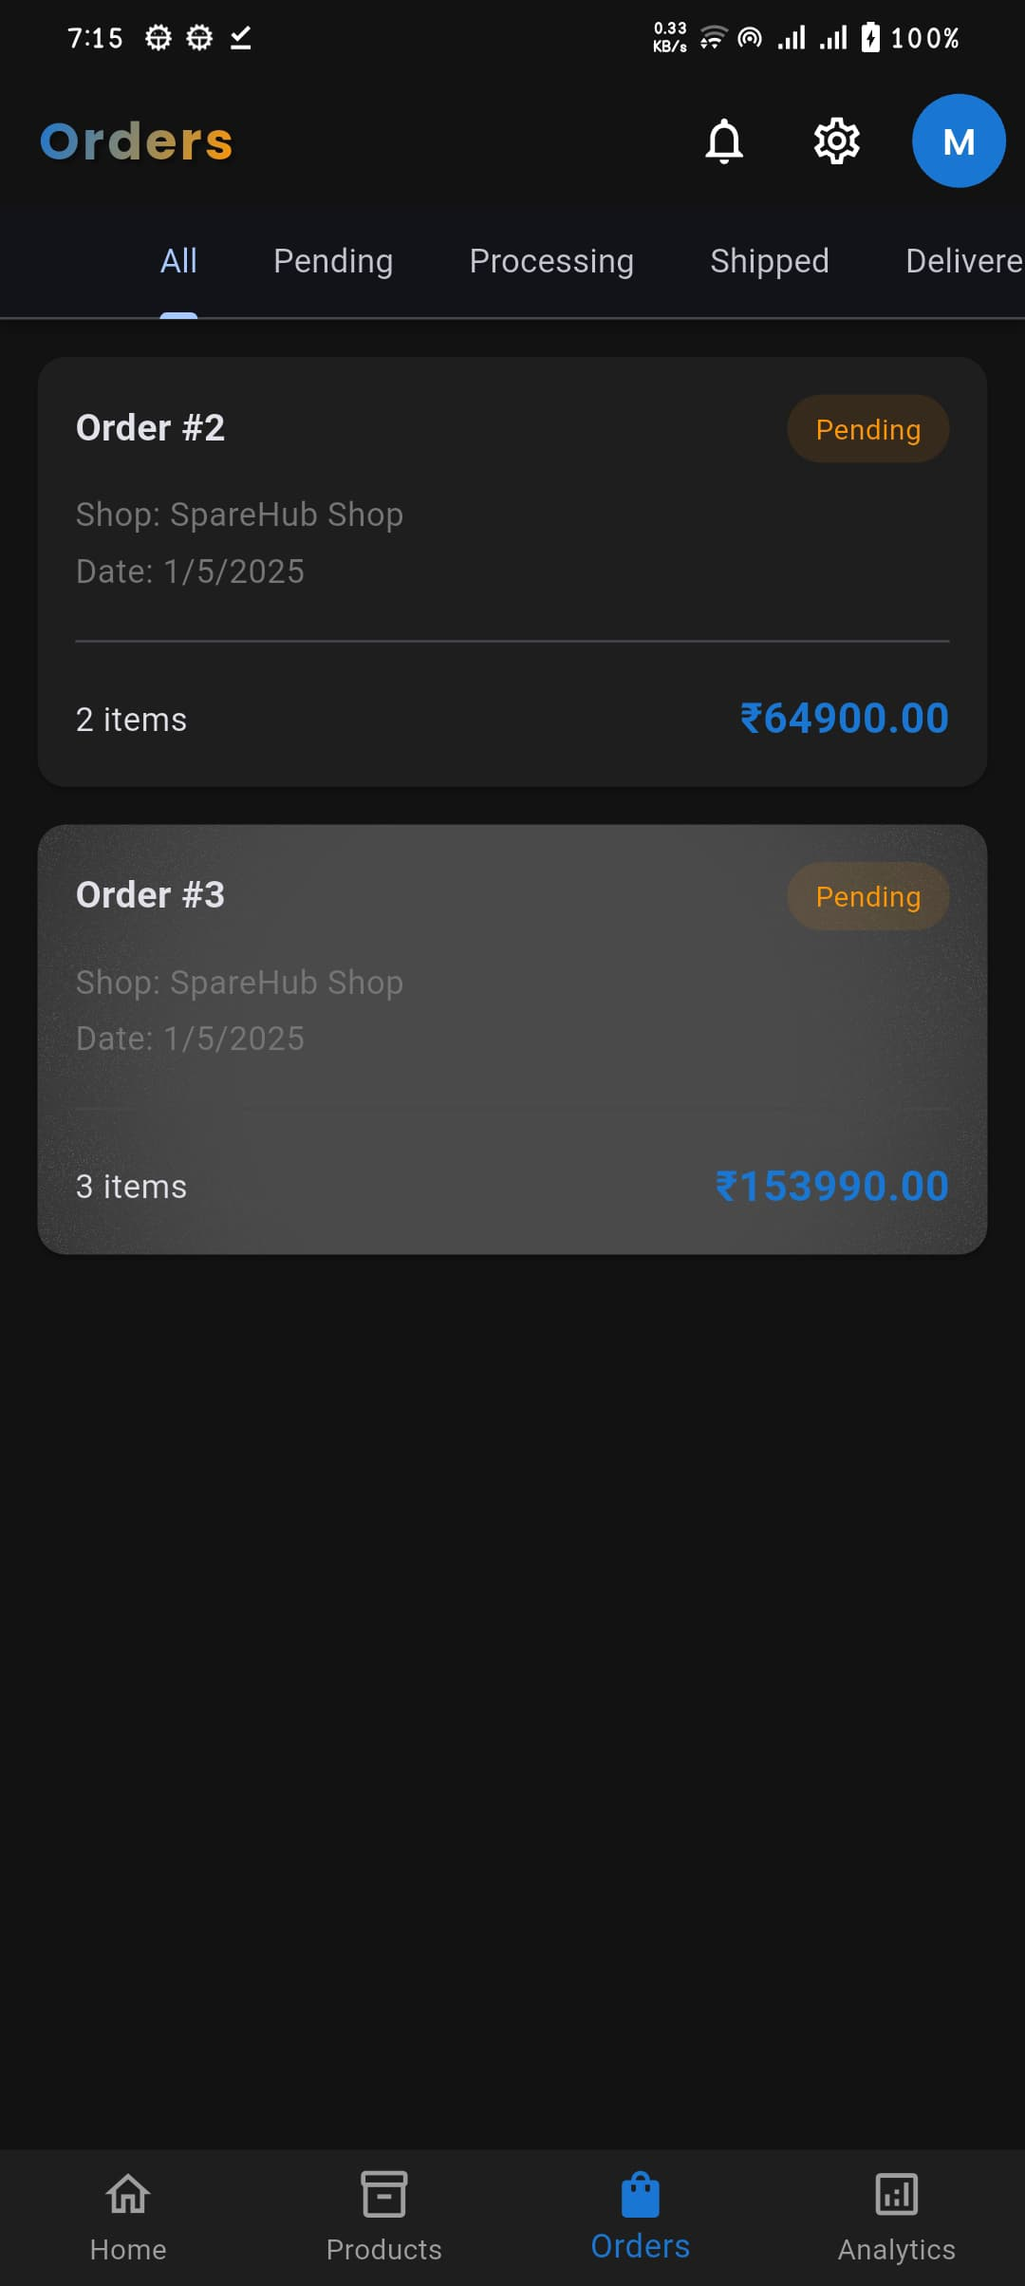

Slide 47
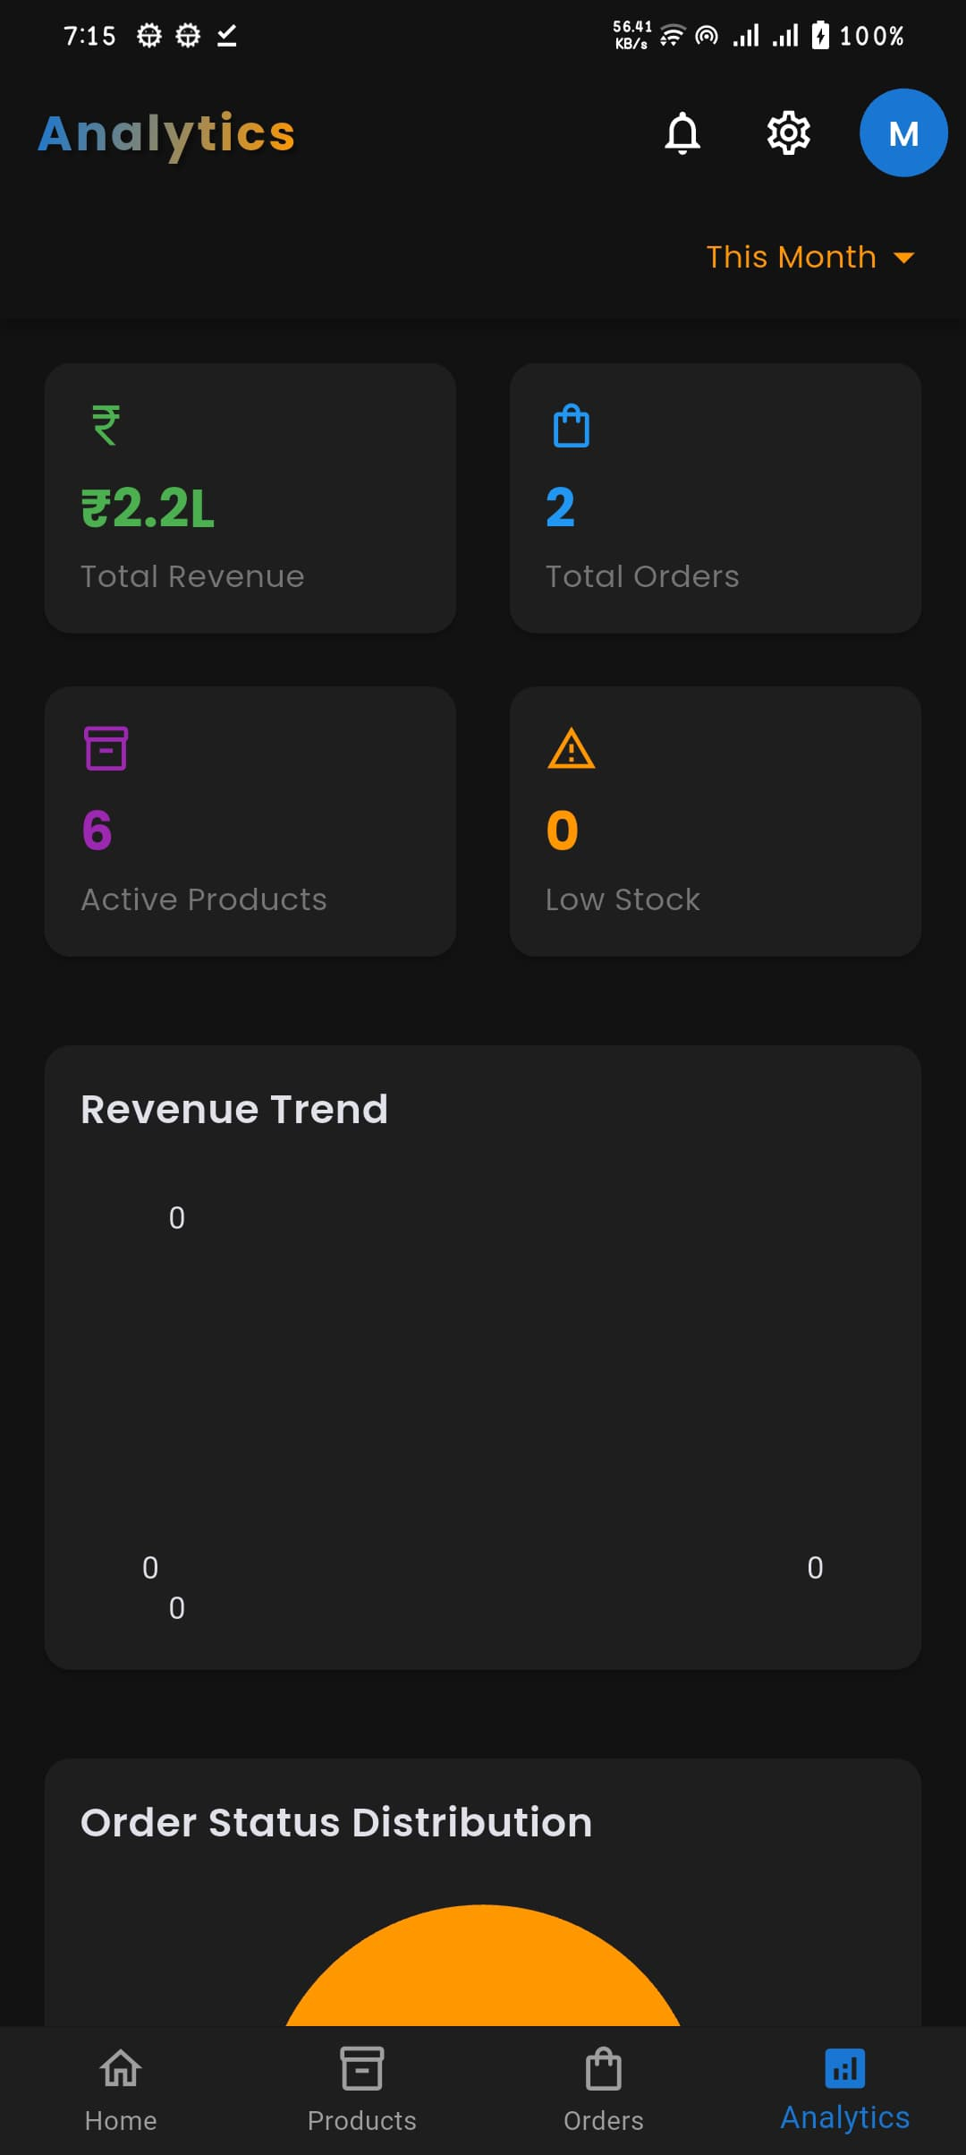
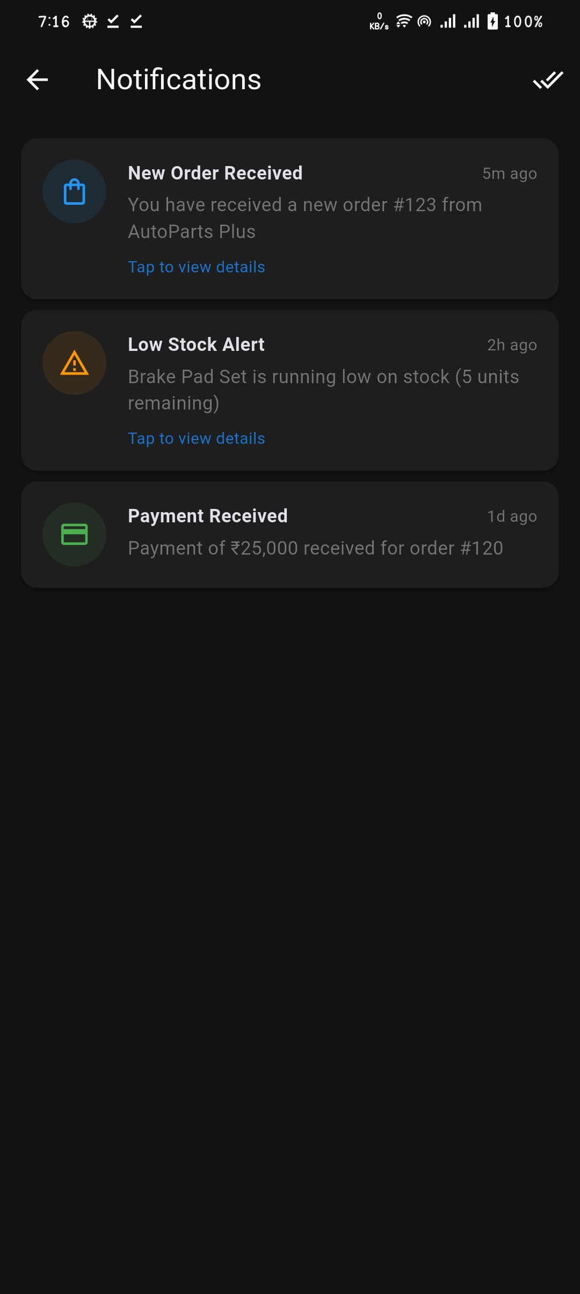
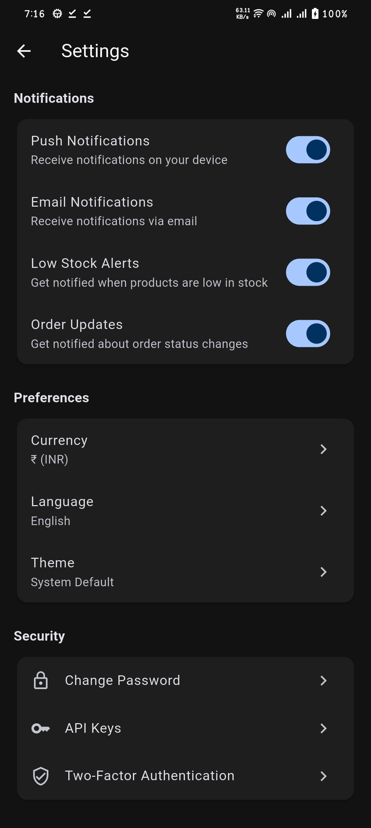
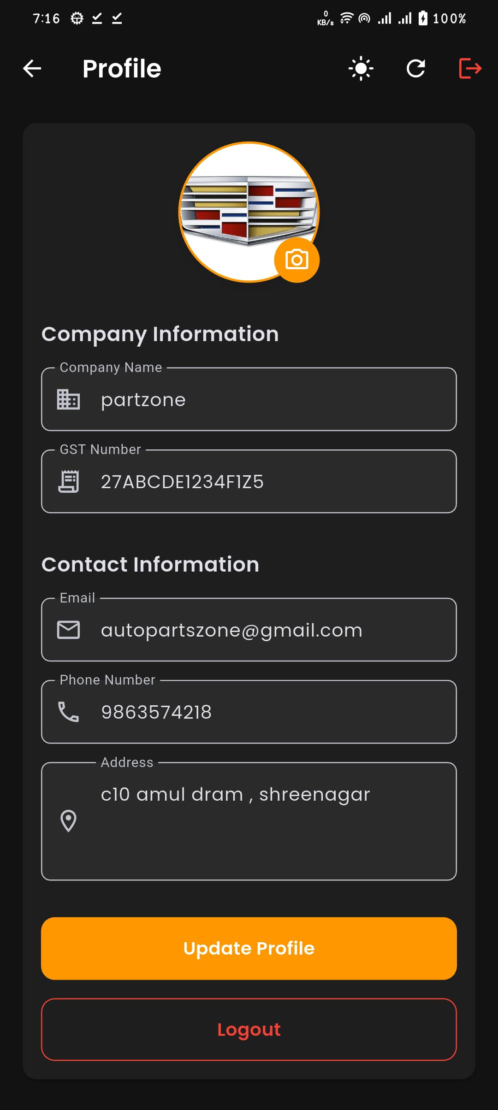

Slide 48
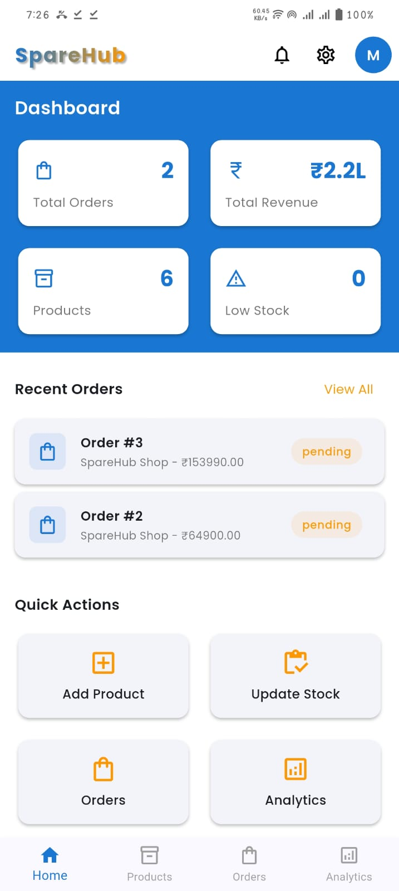




Slide 49





Slide 50






Reference
https://youtu.be/Xr8mfbVHkE8?si=cLRPZzpujWUH3GH1
YouTube
https://youtu.be/Scuefa_53A0?si=JVGlekY0PPK7dD2k
https://youtu.be/GoBrgaZFIjE?si=yNfRMFrbcKJXlBTU
https://boodmo.com
https://tradbuy.in/
https://www.partsbigboss.in
APPLICATION
Google
https://www.geeksforgeeks.org/automobile-industry/?ref=header_ind
AutoZonePro NapaProLin PartsTech
Geeks for Geeks

Slide 51
Contact us

